Slide 1
Halving even numbers to 10
Complete the questions on each slide.
To help you see the number fact, separate the tens frame into 2 equal parts.
The slides are increasingly challenging. Look for these signposts to see if it is relevant for you.
All year groups
Year
1 onwards
Year
3 onwards
Year
4 onwards

Slide 2
Find half of these numbers to 10.
Remember, you can slide the tens frame apart to find 1 half.

Slide 3
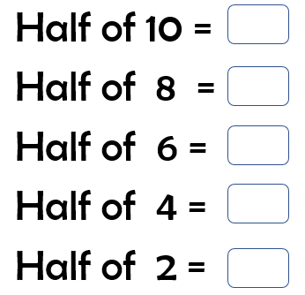

Slide 4
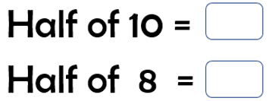

Slide 5
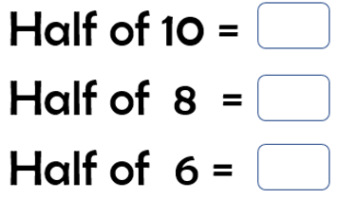

Slide 6
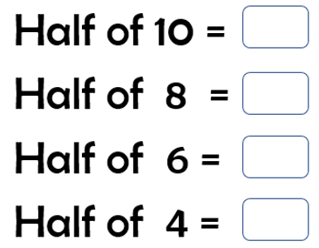

Slide 8
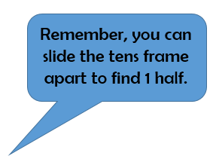
The next set of questions follow the same pattern, but the numbers are 10 times larger.
Each counter now has a value of 10
A full tens frame, now has a value of 100.

Slide 10
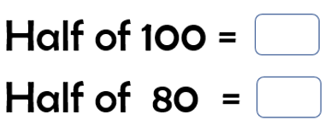

Slide 11
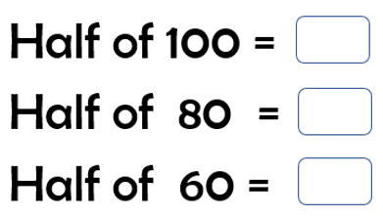

Slide 12
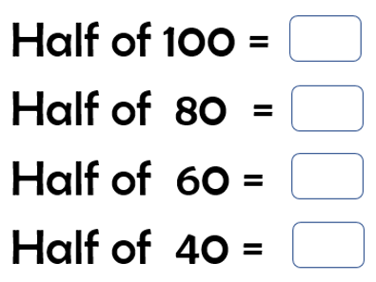

Slide 13
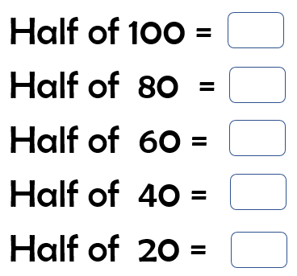

Slide 14
The next set of questions follow the same pattern, but the numbers are 10 times smaller.
Each counter now has a value of 0.1
A full tens frame, now has a value of 1.
0.1

Slide 16
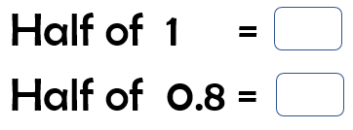

Slide 17
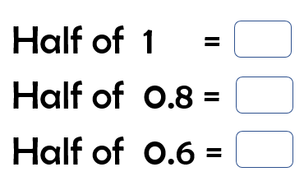

Slide 18
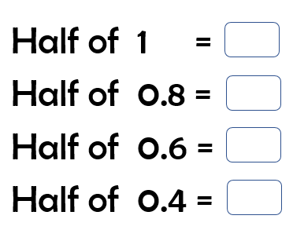

Slide 19
