Slide 1
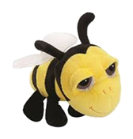
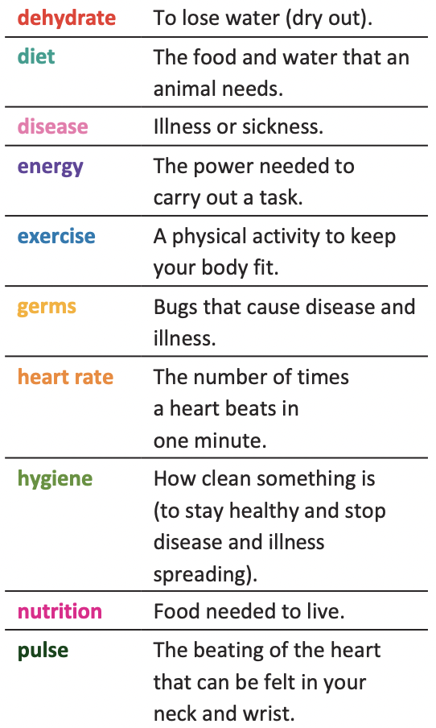
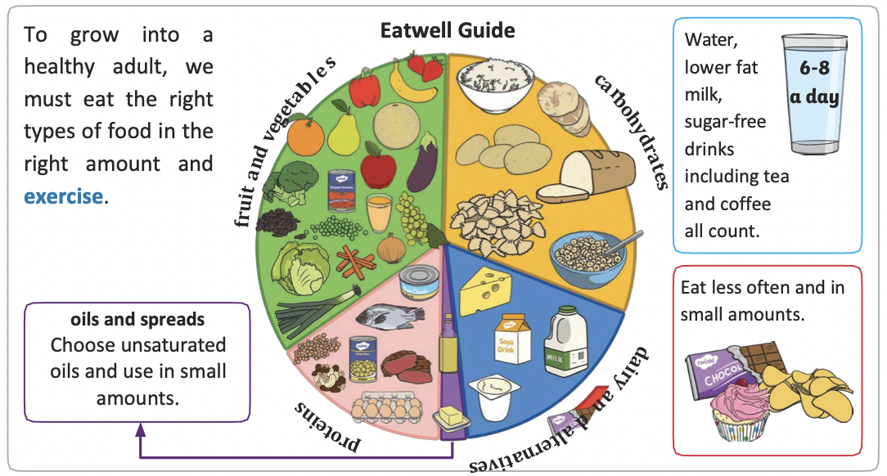
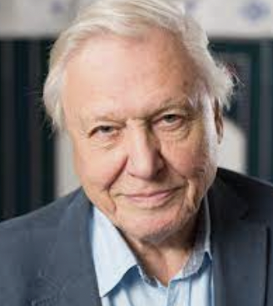
NPA Knowledge Organiser: Year 2 Science – Autumn 2
“I am not an animal lover if that means you think things are nice if
you can pat them, but I am intoxicated by animals.”
David Attenborough

Slide 2
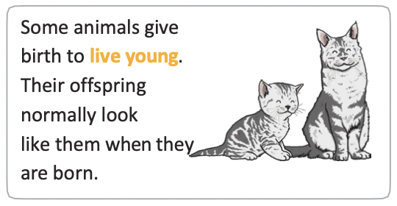
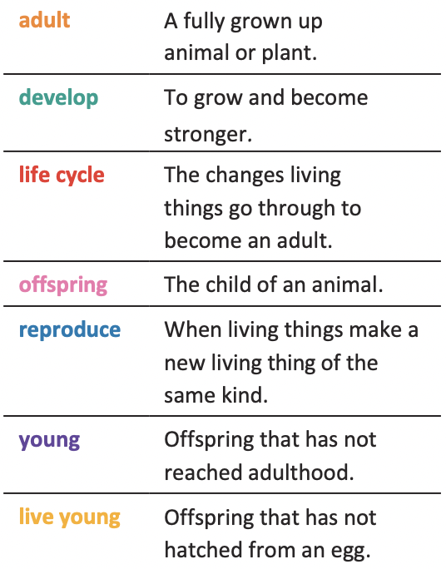
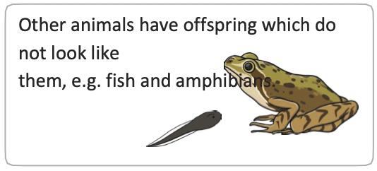
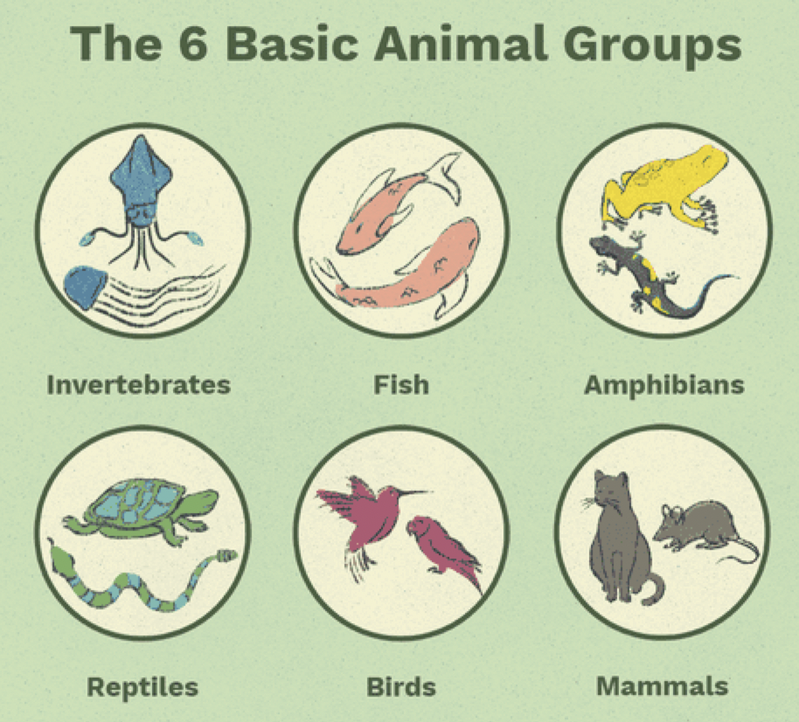
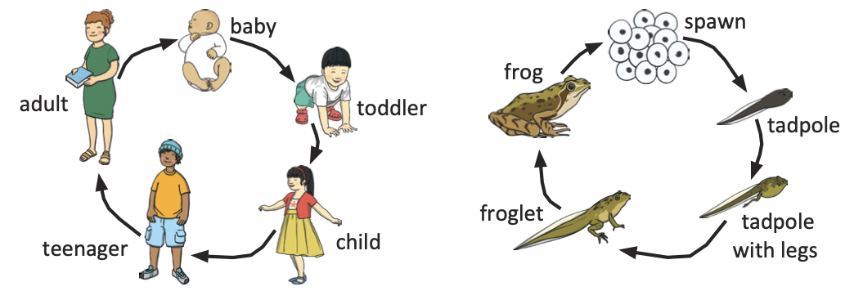
NPA Knowledge Organiser: Year 2 Science – Autumn 2
|Inside a seed
https://www.youtube.com/watch?v=PHq2q_PgiUM
Frog Life Cycle Time Lapse

