Slide 1
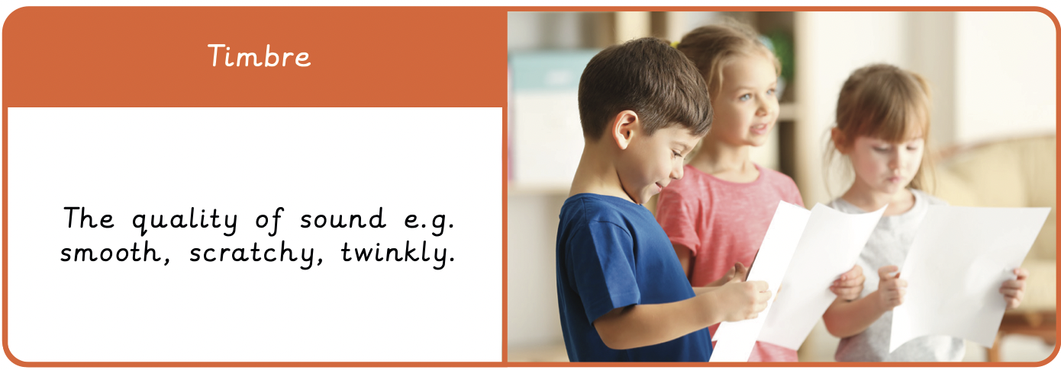
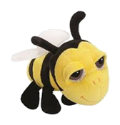
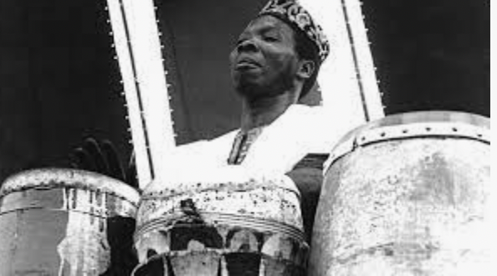
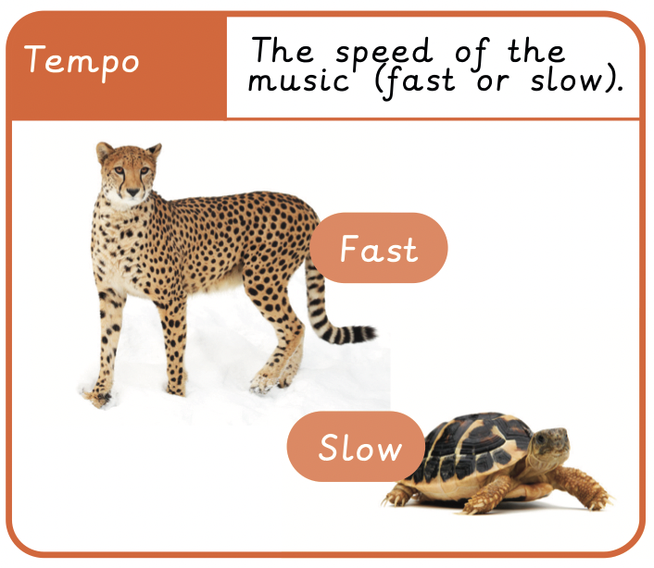
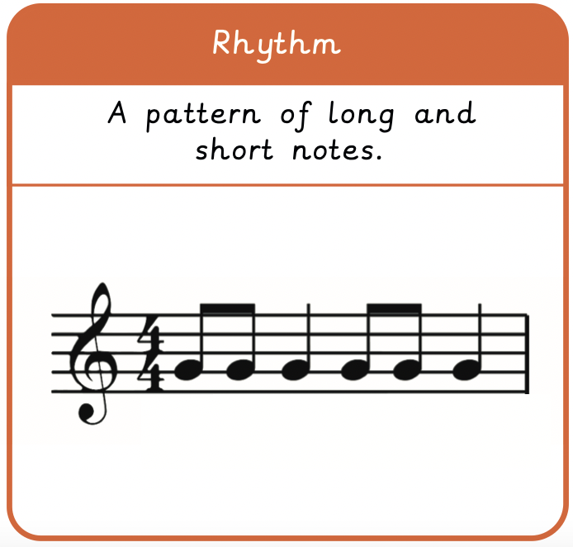
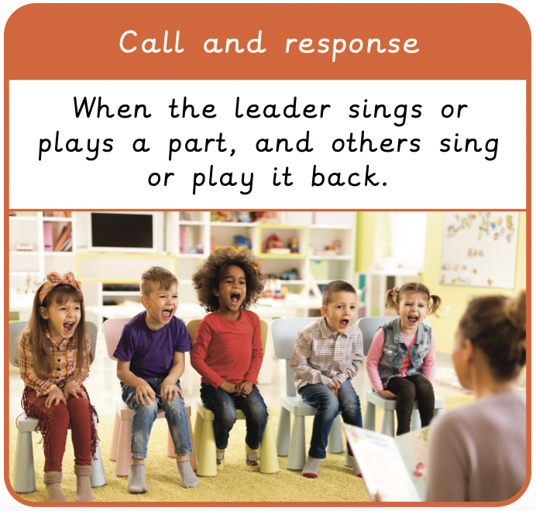
NPA Knowledge Organiser: Year 2 Music – Spring – Amazing Africa
“The creator wants us to drum.
He wants us to corrupt the world with drum,
dance and chants.”
Batatunde Olatunji

Slide 2
NPA Knowledge Organiser: Year 2 Music – Spring - Amazing Africa
https://www.youtube.com/watch?v=_bVb-wjZ2xQ
African drumming with Kids

