Slide 1
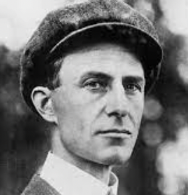
NPA Knowledge Organiser: Year 2 Science – Autumn 1 – The Wright Brothers
http://www.amazingpaperairplanes.com
http://www.amazingpaperairplanes.com
STEM
Design your own paper plane!
“Isn’t it astonishing that all these secrets have been preserved for so many years
just so we could discover them.”
Wilbur Wright

Slide 2
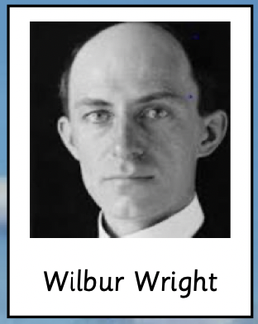
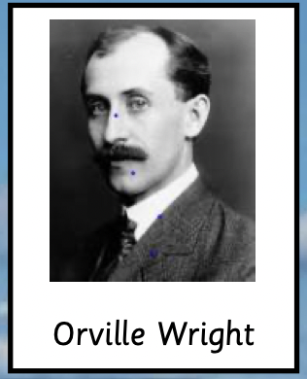
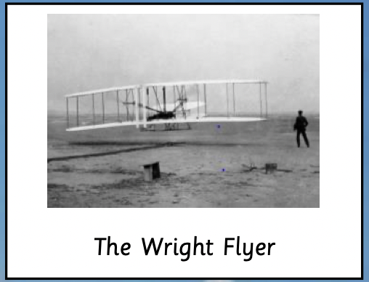
NPA Knowledge Organiser: Year 2 Science – Autumn 1 – The Wright Brothers
https://www.youtube.com/watch?v=-kjRL-Q-KBc
The Wright Brother’s First Flight

