Slide 1
Multiples of 9 (part 1)
Complete the questions on each slide.
To help you, the resources on the screen can be dragged and moved.
The slides are increasingly challenging. Look for these signposts to see if it is relevant for you.

Slide 2
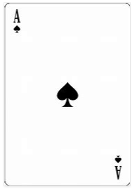
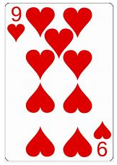
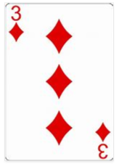
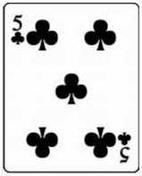
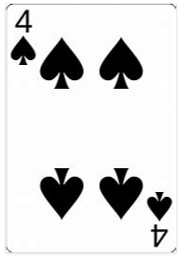
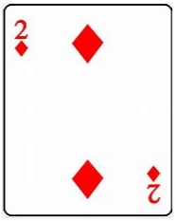
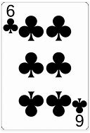
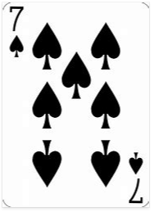
What pairs with each number to make 9?

Slide 3
What numbers can you make using 2 digits that total 9?
These numbers are multiples of 9!

Slide 4
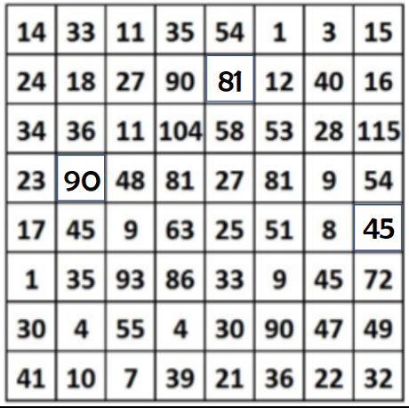
Drag the squares to mark the path from top to bottom.

