Slide 1
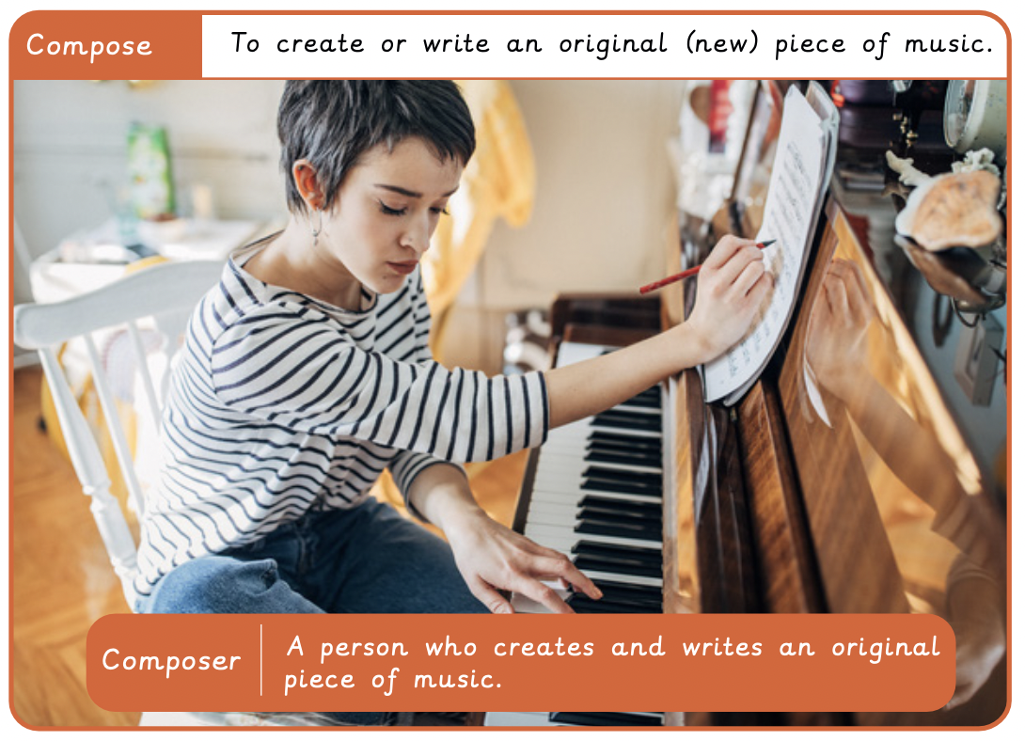
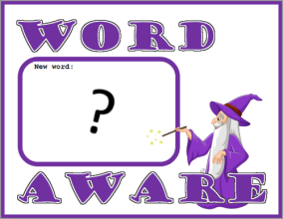
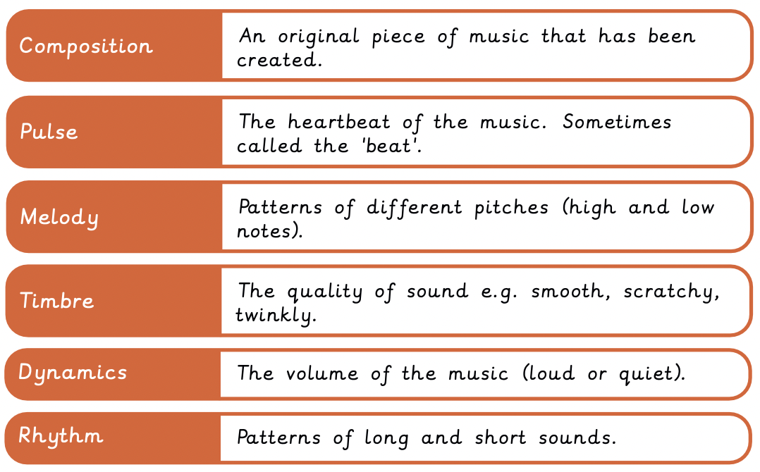
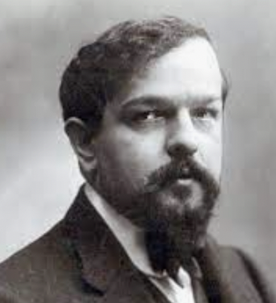
NPA Knowledge Organiser: Year 2 Music – Autumn - Musical Me
”Music is the expression of the movement of the waters, the play of curves described by the changing breezes.” Debussy

