Slide 1
5 Times Tables
Complete the questions on each slide.
To help you, the resources on the screen can be dragged and moved.
The slides are increasingly challenging. Look for these signposts to see if it is relevant for you.

Slide 2
Use your Lego or blocks from your toy box to make towers of 10.
Count in tens.
Can you put them into groups of 5?
What can you spot in the pattern of the numbers?

Slide 3
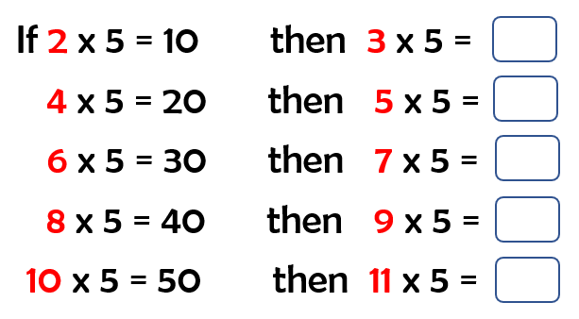
Continue the pattern
Drag the towers to make the groups of ten, to help you.

Slide 4
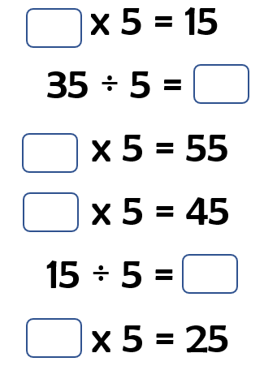
Multiplication and division problems
Drag the towers to make the groups of ten, to help you.

Slide 5
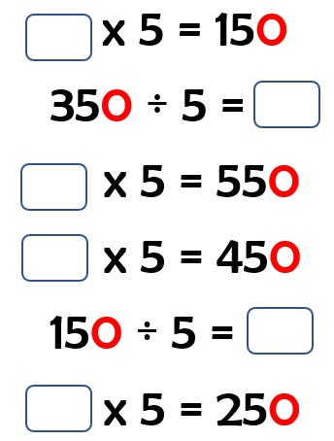
If, 3 x 5 = 15
Then, 30 x 5 = 150
(30 is ten times larger than 3, so the result is also ten times larger).

