Slide 1
Doubling numbers to 10
Complete the questions on each slide.
To help you see the number fact, separate the tens frame into 2 equal parts.
The slides are increasingly challenging. Look for these signposts to see if it is relevant for you.
All year groups
Year
1 onwards
Year
3 onwards
Year
4 onwards

Slide 2
Double these numbers to 10.
Remember, you can slide the tens frame together to find the total of 2 equal groups.

Slide 3
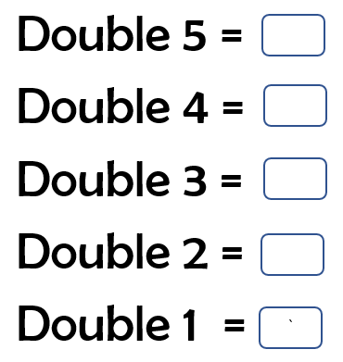

Slide 8
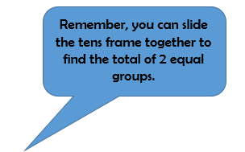
The next set of questions follow the same pattern, but the numbers are 10 times larger.
Each counter now has a value of 10
A full tens frame, now has a value of 100.

Slide 14
The next set of questions follow the same pattern, but the numbers are 10 times smaller.
Each counter now has a value of 0.1
A full tens frame, now has a value of 1.
0.1

