Slide 1
Number Pairs to 9
Complete the questions on each slide.
To help you, the resources on the screen can be dragged and moved.
The slides are increasingly challenging. Look for these signposts to see if it is relevant for you.

Slide 2
Can you recall your pairs to 10? find the pairs?

Slide 3
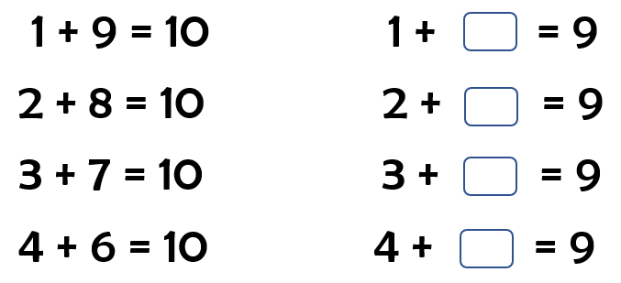
Remember, 9 is 1 less than 10.

Slide 4
