Slide 1
Multiples of 10
Complete the questions on each slide.
To help you, the resources on the screen can be dragged and moved.
The slides are increasingly challenging. Look for these signposts to see if it is relevant for you.

Slide 2
Continue the pattern
1 X 10 = 10
2 X 10 = 20
3 X 10 = 30
4 X 10 = 40
5 X 10 =
6 X 10 =
7 X 10 =
8 X 10 =
9 X 10 =
10 X 10 =
11 X 10 =
12 x 10 =
Drag the towers to make the groups of ten, to help you.

Slide 3
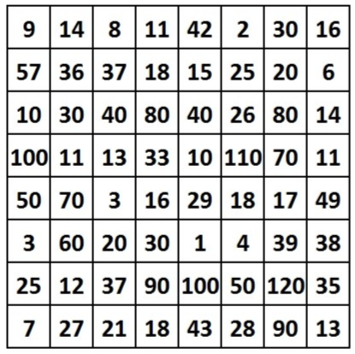
Drag a counter to circle the multiples of ten that follow the path from top to bottom.

Slide 4
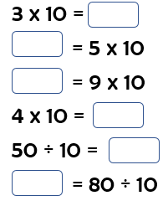
Multiply and Divide by 10

Slide 5
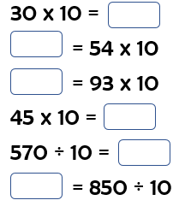
Multiply and Divide by 10

Slide 6
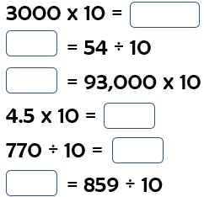
Multiply and Divide by 10

