Slide 1
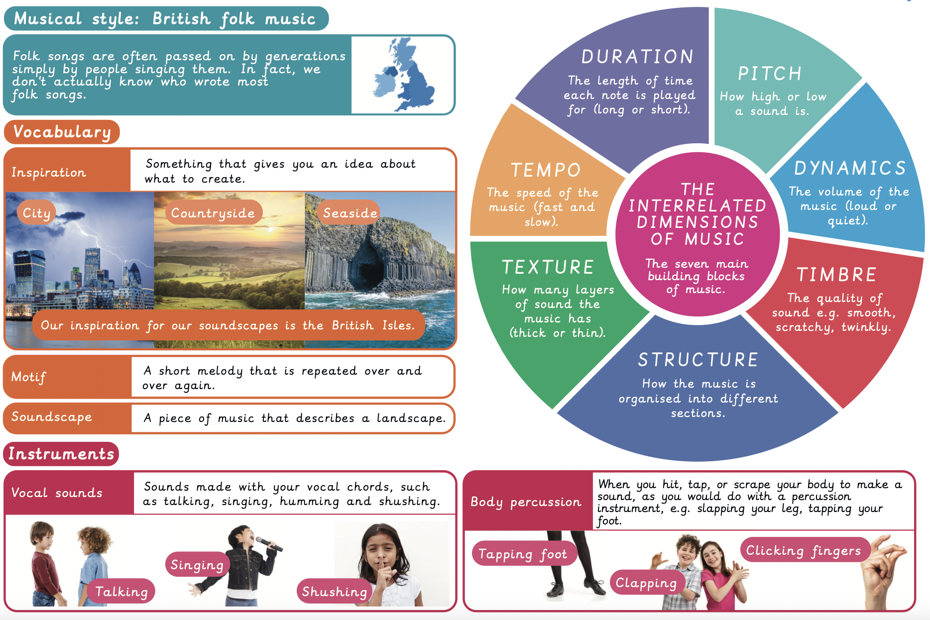
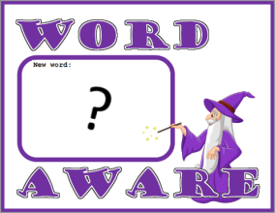
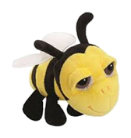
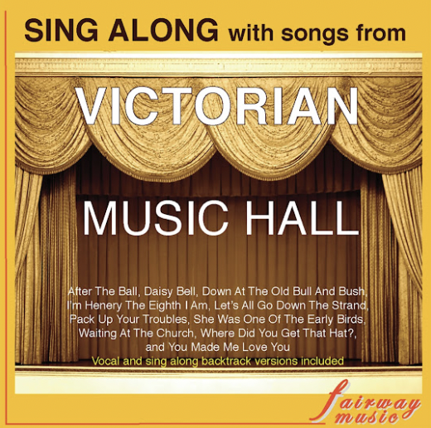
NPA Knowledge Organiser: Year 2 Music – Autumn – On this Island
In Autumn 1 we will listen to Victorian music and learn folk songs that have been passed down through generations.
“The creator wants us to drum.
He wants us to corrupt the world with drum,
dance and chants.”
Batatunde Olatunji
https://music.youtube.com/watch?v=JtsZwnxumiU&list=OLAK5uy_mPUf9R8zacXcNtSX4FuNiBSW1rJBWX1go
Sing along with songs from The Victorian Music Hall

