Slide 1
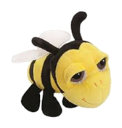
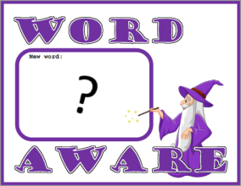
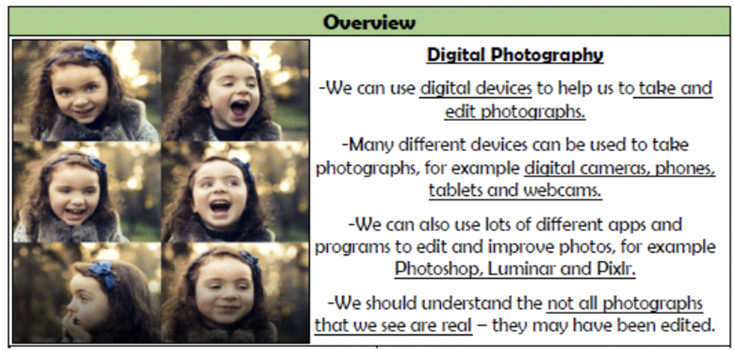
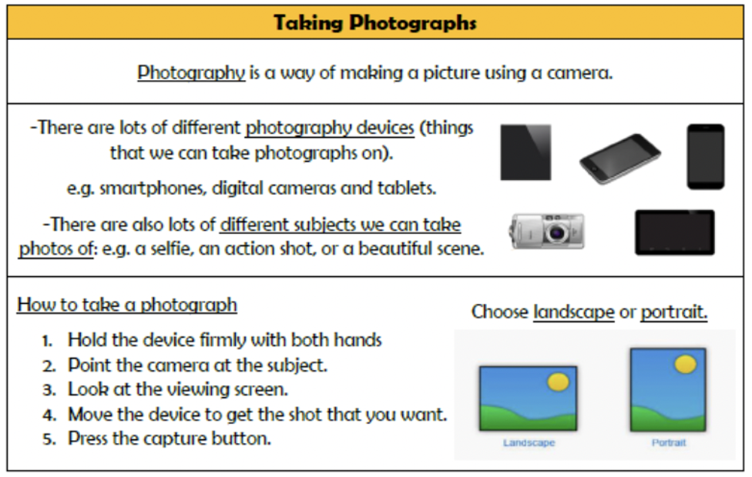
NPA Knowledge Organiser: Year 2 Computing – Autumn 1
photograph
editing
software
digital
portrait
landscape
scene
subject
lighting
colour
focus
blur
capture

Slide 2
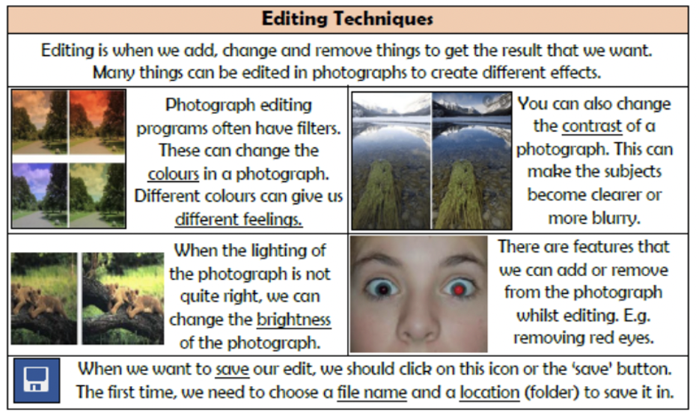
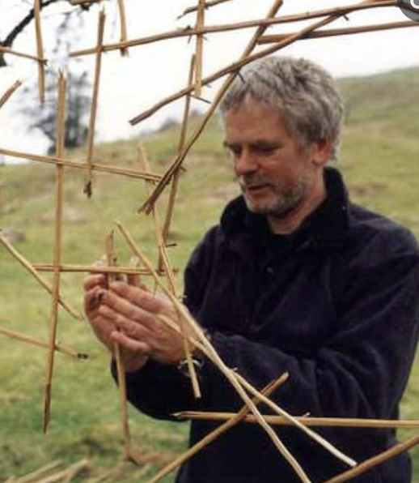
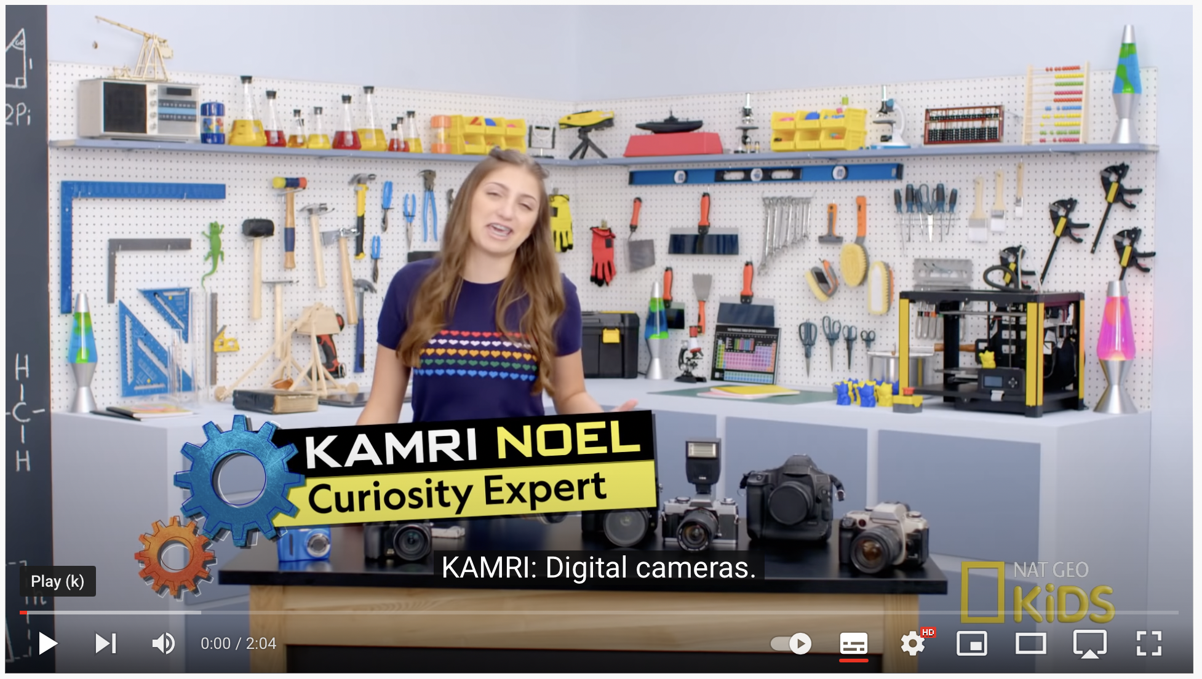
NPA Knowledge Organiser: Year 2 Computing – Autumn 1
Andy Goldsworthy distance between myself and the work which sometimes helps me to see.
“Photography is a way of putting distance between myself and the work which sometimes helps me to see more clearly what it is that I have made.
How do cameras work? Check out the video link below to find out!
https://www.youtube.com/watch?v=Ey6S3rKH_o4

