Slide 1
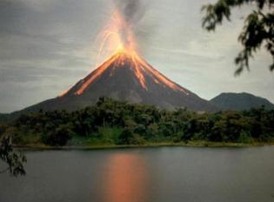
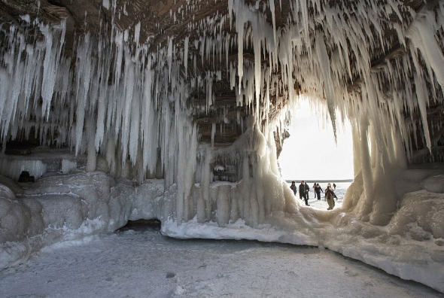
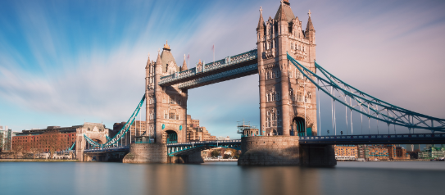
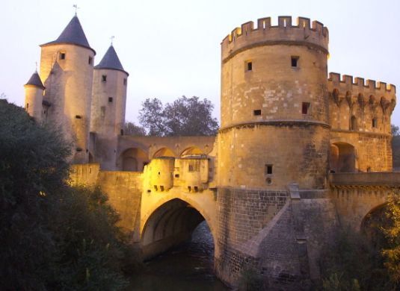
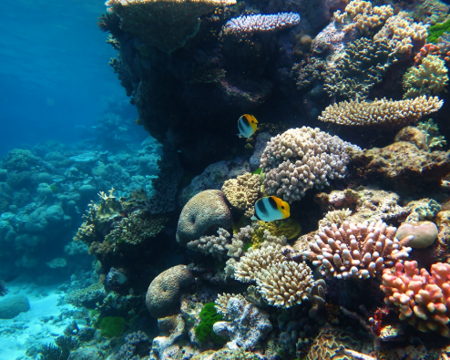
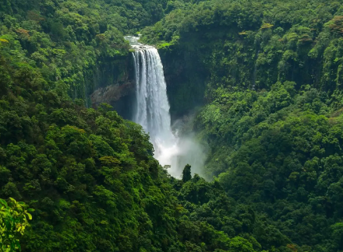
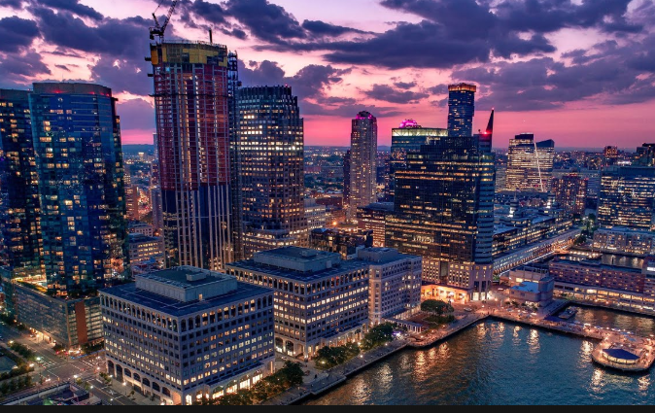
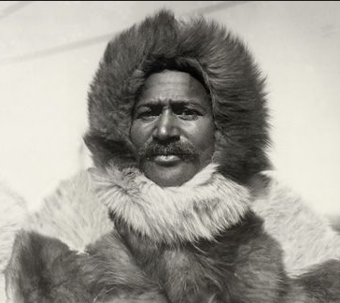
NPA Knowledge Organiser: Year 2 Geography – Summer
Geography: The study of the Earths surface and its features.
Physical feature: Landforms that develop in our natural environment.
Human feature: Aspects of our environment that were built by humans.
City: A large or important town.
Country: An area of land that is controlled by it’s own government.
Continent: A large area of land made up of several countries.
Volcano: A mountain with a vent, through which lava can erupt from the Earths crust.
Waterfall: A cascade of water falling from a height.
Cave: A natural underground chamber in a hillside.
Barrier Reef: area of coral reef near the shore.
Aerial: A view from above.
Floor plan: A scale diagram of the arrangement of rooms in a building.
Topic – castles and dragons
Which features are
physical?
Which features are human?
bridge
castle
city
volcano
cave
Barrier reef
waterfall
Matthew Henson
Henson was an African American Arctic explorer. He was the first man to reach the North Pole which he did in 1909.
https://www.bbc.co.uk/bitesize/subjects/zcdqxnb

Slide 2
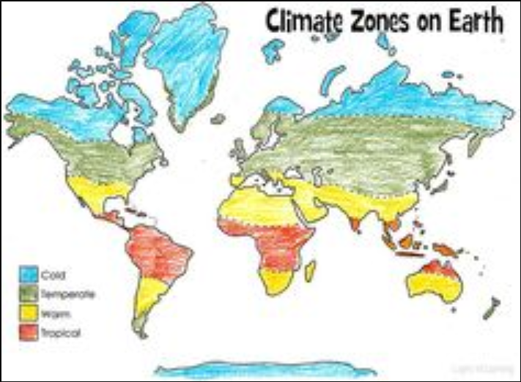
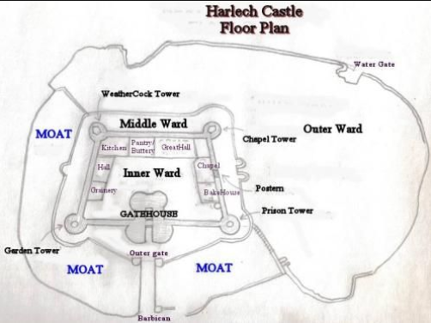
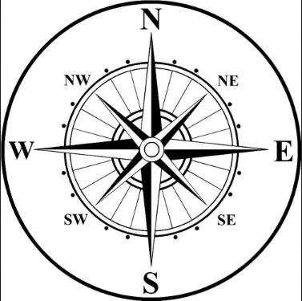
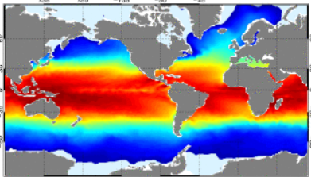
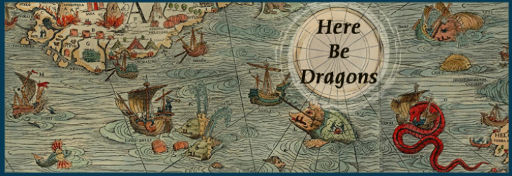
NPA Knowledge Organiser: Year 2 Geography – Summer 1
By the end of this unit, you’ll know:
The key physical characteristics of the seven continents of the world.
The key physical characteristics of the 5 oceans of the world.
How human action impacts the environment and the landscape.
The impact of global warming on different landforms across the world.
That environments are changing constantly as a result of both natural phenomena and human action.
Temperature of our continents
Temperature of our oceans
‘What you do makes a difference. You just have to decide what kind of difference you want to make.’ Jane Goodall

