Slide 1
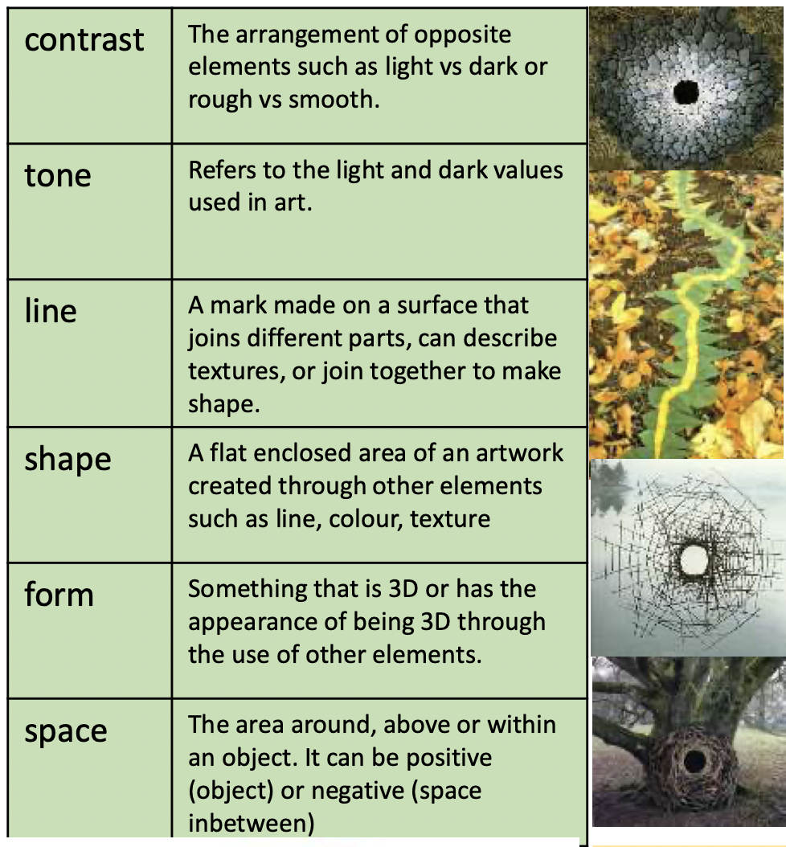
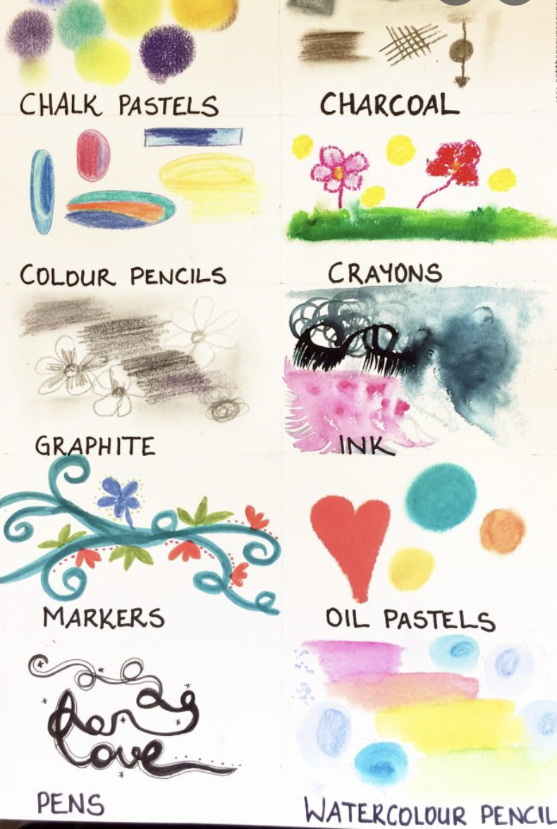
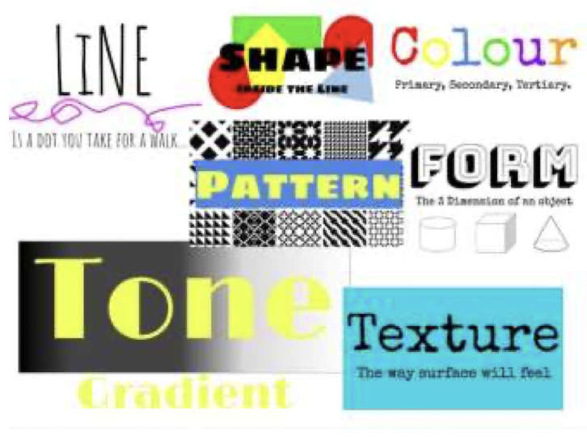
NPA Knowledge Organiser: Year 2 ART and DESIGN – Drawing and Sketching Autumn
v
Sketch
Books

Slide 2
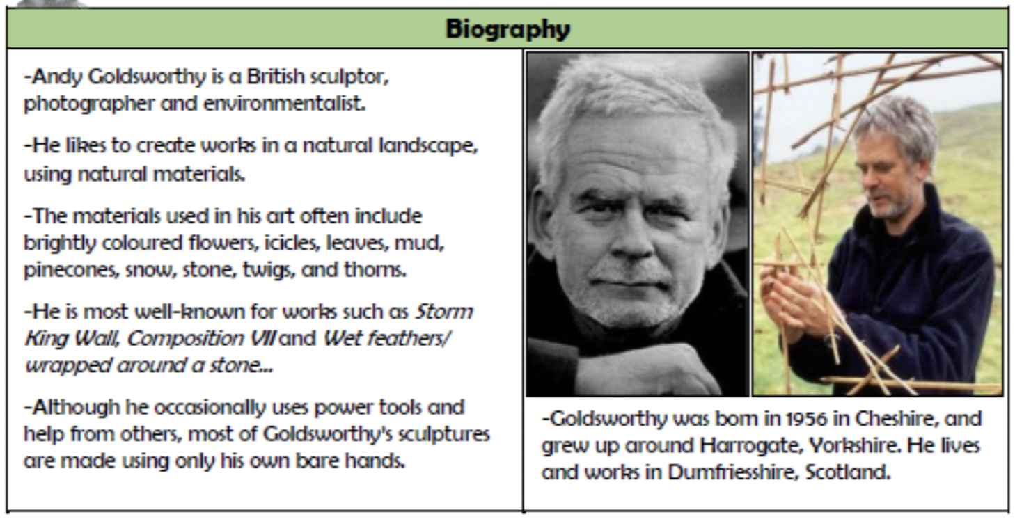
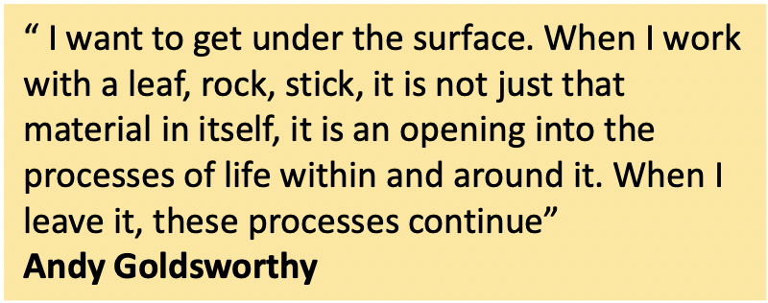
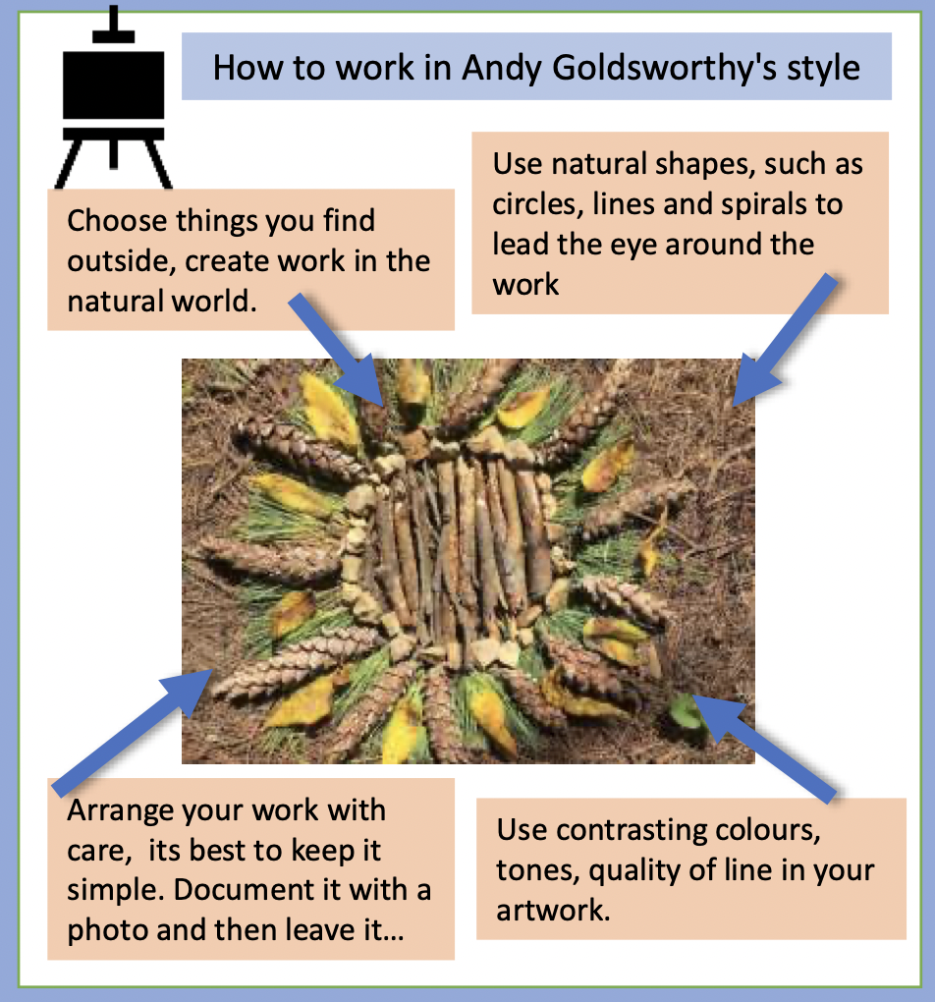
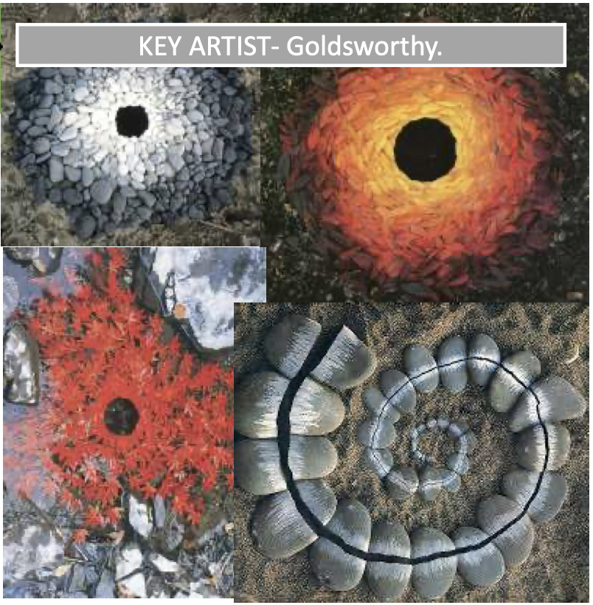
NPA Knowledge Organiser: Year 2 ART and DESIGN – Drawing and Sketching Autumn
Jesus said, “I am the Light of the World. Whoever follows me will never walk in darkness but have the light of life.” (John 8:12) Jesus is speaking of the light of His truth, the light of His word and the light of eternal life.
How was Jesus a light/guide?
https://www.youtube.com/watch?v=LdmqR2qwCYo
How to sketch

