Slide 1
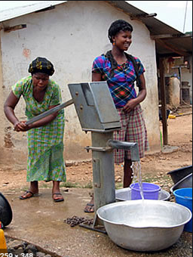
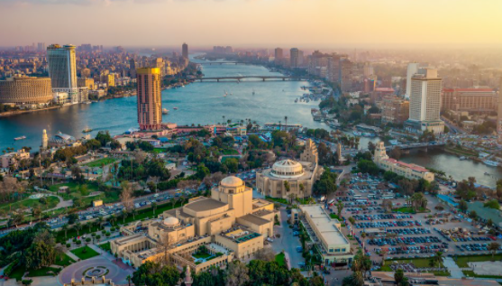
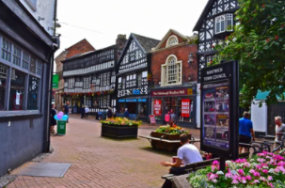
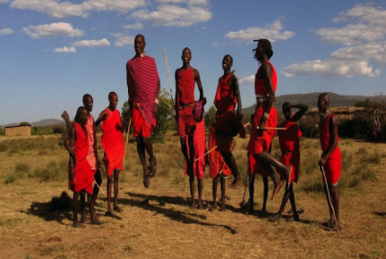
NPA Knowledge Organiser: Year 2 Geography - Spring – Amazing Africa
Continent: a large area of land that consists of several countries.
Country: an area of land that is controlled by a single government.
Ocean: each ocean is a large body of water that the Earths water is divided into.
Equator: a line around Earth that is equal distance from the poles that splits the planet into the Northern and Southern hemisphere.
Climate: a weather condition that occurs for a long period of time.
Physical feature: the natural features of the Earth like rivers, mountains and seas.
Human feature: the man-made features of the Earth that are linked to people and places, like houses and bridges.
Landform: natural features of the Earth such a hills, valleys or seas.
Culture: the way of life of a particular people.
Life in Africa varies depending which country you live in. Some aspects of life in Nantwich are similar but much is very different.
“If I have ever seen magic, it has been in Africa.”
John Hemingway

Slide 2
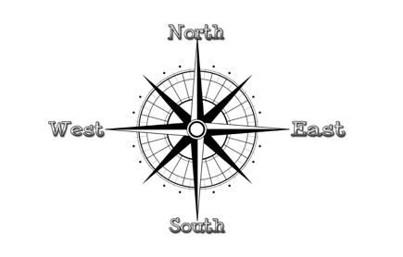
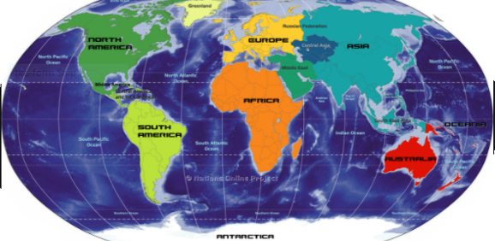
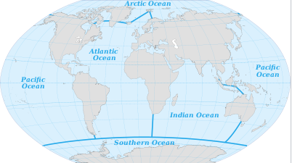
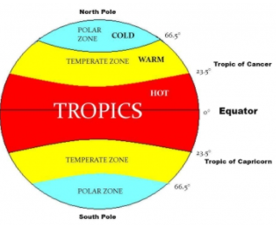
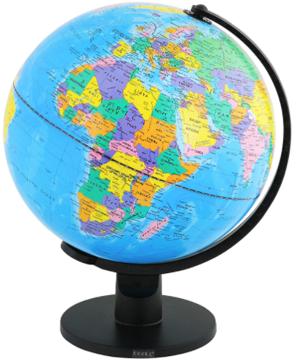
NPA Knowledge Organiser: Year 2 Geography – Spring - Amazing Africa
The continent of Africa
UK
equator
Africa
The 5 ocean’s of the world
Global Climate
Come explore...Africa with Lonely Planet Kids – YouTube
http://www.youtube.com/watch?v=PSYHMWmyVfo
Come explore...Africa with Lonely Planet Kids - YouTube

