Slide 1
Doubling numbers to 20
Complete the questions on each slide.
To help you see the number fact, separate the tens frame into 2 equal parts.
The slides are increasingly challenging. Look for these signposts to see if it is relevant for you.
All year groups
Year
1 onwards
Year
3 onwards
Year
4 onwards

Slide 2
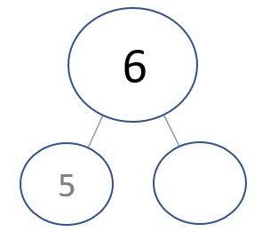
Use 5 to double numbers to 20

Slide 3
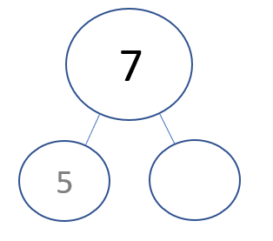
Use 5 to double numbers to 20

Slide 4
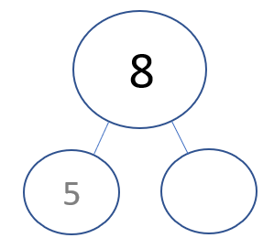
Use 5 to double numbers to 20

Slide 5
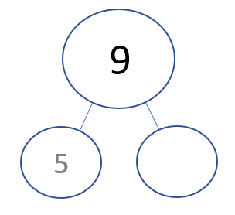
Use 5 to double numbers to 20

Slide 6
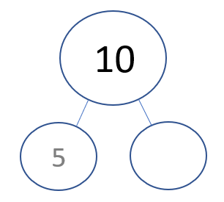
Use 5 to double numbers to 20

Slide 7
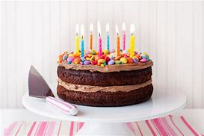
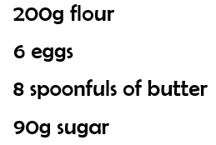
Help Sally to double her ingredients to bake 2 cakes.

