Slide 1
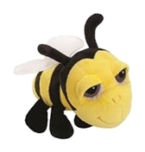
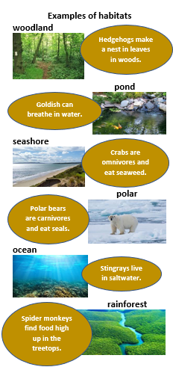
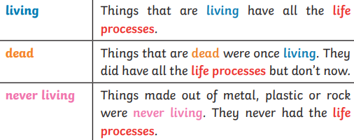
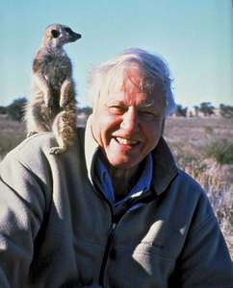
NPA Knowledge Organiser: Year 2 Science – Spring 1

Slide 2
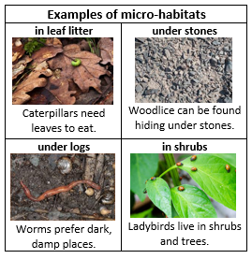
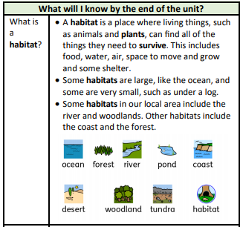
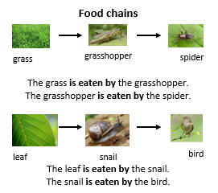
NPA Knowledge Organiser: Year 2 Science – Spring 1 Living things and their habitats
https://www.dkfindout.com/uk/animals-and-nature/habitats-and-ecosystems/

