Slide 1
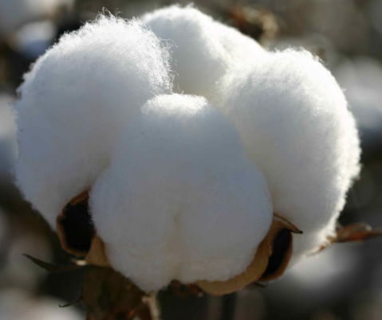
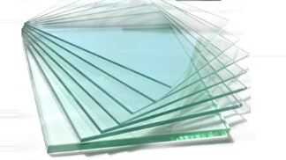
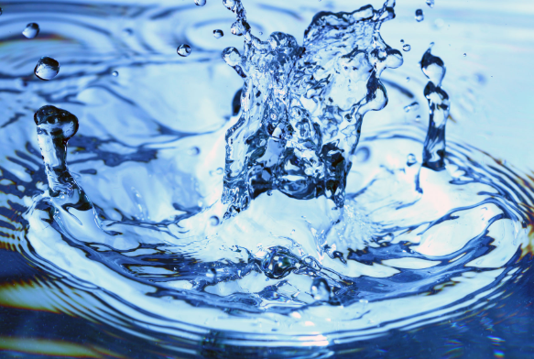
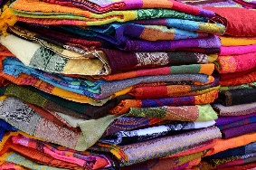
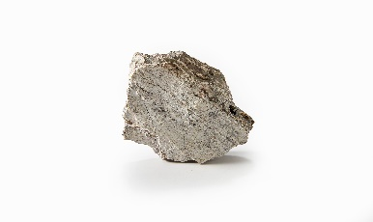
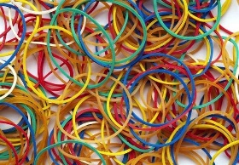
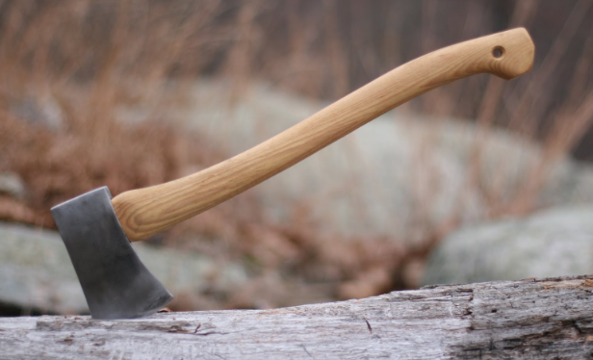
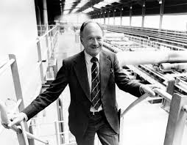
NPA Knowledge Organiser: Year 2 Science – Summer 1
Material: A material is anything made from matter than can be shaped or manipulated in order to make something.
Matter: Anything that physically occupies space.
Natural: A material made directly from matter in our environment.
Manufactured: A new material made by humans, by combining natural materials and changing the properties of the resultant material.
Synthetic: A substance made by humans by mixing natural materials to form a new material.
Opaque: Not able to be seen through
Transparent: is able to be seen through
Translucent: allows some light to pass, so basic shape are able to been seen through
Reflective: capable of reflecting light.
Non-reflective: not capable of reflecting light.
Flexible: capable of bending
Rigid: not capable of bending
Materials
Which materials are
natural?
Which materials are manufactured?
Rock
Water Air
Plant fibers
wood
glass
Rubber
Paper
fabrics
Alastair Pilkington (1920) inventor of float glass.
Float glass is a sheet of glass made by floating molten glass on a bed of molten metal. This method gives the sheet uniform thickness and very flat surfaces. Modern windows are made from float glass.
https://www.dkfindout.com/uk/science/materials/

Slide 2
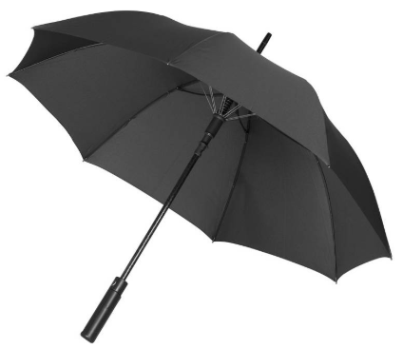
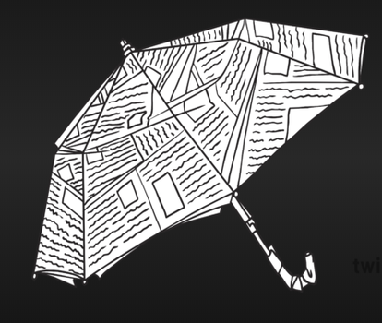
NPA Knowledge Organiser: Year 2 Science – Summer 1
By the end of this unit, you’ll know:
All objects are made of one or more materials that are chosen specifically because they have suitable properties for the task.
When choosing what to make an object from, the properties needed are compared with the properties of the possible materials, identified through simple tests and classifying activities.
A material can be suitable for different purposes and an object can be made of different materials.
Objects made of some materials can be changed in shape by bending, stretching, squashing and twisting.
Unsuitable properties
Suitable properties
Metal
shaft
Rigid and strong
Not
waterproof
Not
strong
Fabric canopy
paper
Rubber
handle
Not
durable
Not
rigid
Stretchable and waterproof
Durable
And
flexible
N
‘Nothing can come out of nothing, any more than a thing, can go back to nothing.’
Marcus Aurelius

