Slide 1
Nantwich Primary Academy and Nursery
New Starter Presentation
Nurturing every child on the pathway to success

Slide 2
Induction Pack
This will be posted to you and contains:
A welcome to Reception booklet.
Before and After School Club information
Dates for school holidays for next year
School Uniform Order Sheet
These need to be returned to school:
School Registration Form
Permissions Sheet
Nantwich Primary Academy and Nursery

Slide 3
What is the Foundation Stage?
The Early Years Foundation Stage (EYFS) begins at birth, through to attendance in a nursery setting (from aged 3 at Nantwich Primary Academy).
The final year of the Foundation Stage is in a Reception class of a primary school.
Nantwich Primary Academy and Nursery

Slide 4
What is the Foundation Stage?
The Early Years Foundation Stage curriculum is split into seven areas of learning…
Prime Areas (the basis of all learning):
Personal, Social and Emotional Development
Physical Development
Communication and Language
Nantwich Primary Academy and Nursery

Slide 5
What is the Foundation Stage?
And…
Specific Areas (build upon the Prime Areas):
Literacy
Mathematics
Understanding the World
Expressive Arts and Design
Nantwich Primary Academy and Nursery

Slide 6
School Hours
Reception Children
Monday to Friday 8.30am – 3.15pm
We have our own entrance and exit door off the main playground. There is always a member of staff on the yard in the morning. Gates open at 8.30am and close at 8:40am. Children must be supervised into school.
Attendance
If your child is ill, please ring the school office as early as possible on the first day they are off school and every morning they continue to be off school.
Please try and arrange appointments to either after school or during school holidays.
Nantwich Primary Academy and Nursery

Slide 7
A typical day in Reception
Time
8.30am | Enter school, coats on pegs and into classroom
8.40am | Registration, toast and dinner choices
9.00am | Whole class Literacy input
9.20am | Reading with teacher led and independent learning time indoors and outdoors
10.15am | Snack (milk and fruit)
10.30am | Teacher led and independent learning time indoors and outdoors
11.00am | Phonics
11.35am | Lunch (school hall) and playtime (EYFS outdoor area)
13.00pm | Registration
13.05pm | Whole class Mathematics input
13.25pm | Teacher led and independent learning time indoors and outdoors
14.45pm | Tidy up, story and songs
15.15pm | Hometime
Nantwich Primary Academy and Nursery

Slide 8
Tapestry
Each child’s development is assessed against their progress through the curriculum towards the final stage – the Early Learning Goals.
Evidence is collected throughout the year in English and Maths books, but also through an online journal called Tapestry.
This is a secure website which also has a free app for parents to see their own child’s learning during their time in the Early Years Foundation Stage.
This app has a login in and a password which will be sent to you once we have permissions. It also enables you to upload photographs and comments from home.
You will also be given an opportunity to have a copy of your child’s journal when they reach the end of Reception.
Nantwich Primary Academy and Nursery

Slide 9
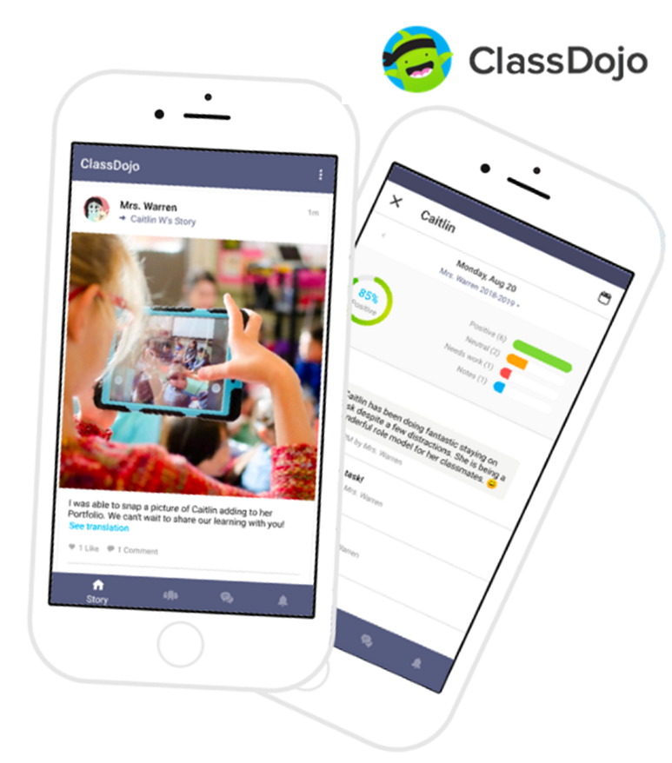
Class Dojo
Our positive behaviour and messaging system
Class Dojo is our positive behaviour management and messaging system linking school and home.
Children collect ‘Dojo points’ for various behaviours and these can be viewed by home too.
Messages can be sent directly to the teacher.
You will also receive whole class and whole school messages sometimes.
‘Class Story’ allows you to see what the class has been learning at school, like a weekly news letter.
Nantwich Primary Academy and Nursery

Slide 10
Being School Ready
Can your child…..?
Cut up their own food using a knife and fork?
Put on their own coat?
Be independent going to the toilet and washing their own hands?
Get dressed and undressed on their own?
Recognise their name?
Nantwich Primary Academy and Nursery

Slide 11
How can I help my child with…
Literacy?
Read, read, read!
Discuss the pictures in books to develop vocabulary.
We teach the skills, it is families that practise them.
Practise your child’s pack of tricky words.
Practise phonic sounds.
Encourage mark making, writing name and other words.
Nantwich Primary Academy and Nursery

Slide 12
How can I help my child with…
Mathematics?
Complete any maths homework activity.
Recognise numerals to 20 and practise writing them.
Practise counting at any time, climbing the stairs, shopping, looking at number plates on cars.
Play simple board games.
Sing number rhymes and songs together.
Nantwich Primary Academy and Nursery

Slide 13
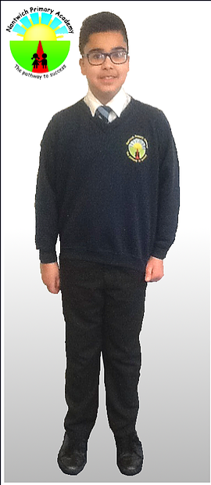
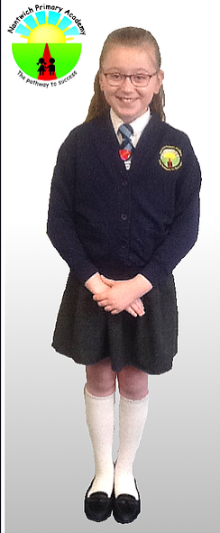
Uniform
Reception and Nursery School Uniform
Girls:
​
White polo short
Blue school jumper (with logo)
Black/grey skirt or trousers
Black/grey/white socks or tights
Black school shoes
(School ties are worn by the older children)
Boys:
​
White polo shirt
Blue school jumper (with logo)
Black or grey trousers
Black / grey socks
Black school shoes
(School ties are worn by the older children)
Blue check summer dresses/shorts can be worn
in the summer term.
Nantwich Primary Academy and Nursery

Slide 14
School Shoes
It is really important that your child wears suitable school shoes.
Your child will play outside daily no matter the weather. Sometimes they will wear wellies but most of the time shoes should be suitable for riding bikes, climbing, swinging and exploring and should not ‘catch’ on equipment.
Trainers and canvas shoes are not suitable and are not part of our school uniform policy.
We recommend Velcro fastening shoes as they are easy for your child to take on and off.
Please make sure your child can recognise their own shoes, put them on the right feet and take them off independently. Please ensure that shoes are named as children often have the same style and size!
Nantwich Primary Academy and Nursery

Slide 15
Other Matters
Please make sure that names are in EVERYTHING including shoes and coats.
Send named coats in EVERY DAY
No jewellery or watches should be worn
Only soft, small headbands in school colours should be worn.
School jumpers and cardigans are available from the office.
Nantwich Primary Academy and Nursery

Slide 16
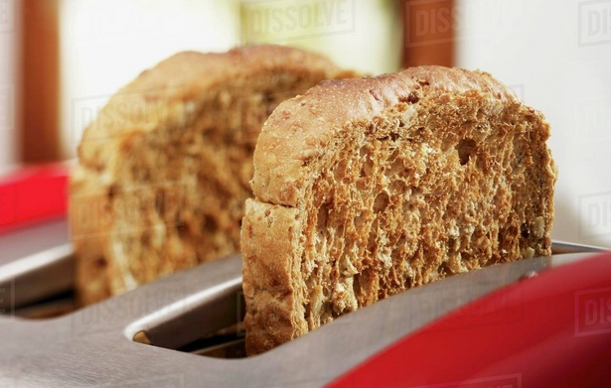
Other Matters
EYFS Donation is £1 per week. This can be paid online via School Money. Toast, fresh playdough, sensory ingredients and other resources are also paid out of this fund.
Each child has a slice of toast every morning as they come into school. Your child is still expected to have breakfast at home, it is just a way of settling your child into the day and filling that ‘hungry gap’ until mid-morning snack and lunchtime.
They have fruit and milk mid-morning.
Milk is free until your child turns 5 but it can be paid for after this date
Nantwich Primary Academy and Nursery

Slide 17
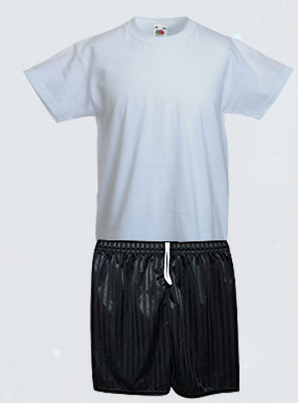
We provide…
Each Reception child receives:
A named water bottle
A Nantwich Primary Academy School book bag which needs to be brought into school every day.
Nantwich Primary Academy and Nursery

Slide 18
All you need to get…
Each Reception child will need:
A NAMED pair of dark coloured, Velcro trainers
A pair of NAMED welly boots for our outside area.
A NAMED waterproof coat that your child can do up themselves. Long coats with belts are not safe on our climbing equipment.
School uniform including a cardigan or jumper from the Office.
Velcro fastening black school shoes.
Please do not get an additional bag or ruck sack for your child, we do not have room to store them and everything your child needs will be in their school book bag.
Nantwich Primary Academy and Nursery

Slide 19
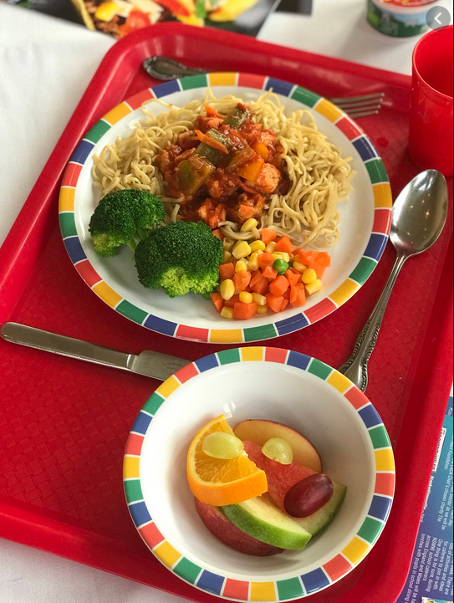
School Meals
All Children in Reception, Year 1 and Year 2 are entitled to
Universal Infant Free School Meals.
The menus are rotated on a three-weekly cycle and are cooked in our school by qualified catering staff. All meals are nutritionally balanced and locally sourced where possible.
The menu is available on our school website, but we also develop independence by enabling the children to make choices themselves (with adult support).
Please ensure that any dietary requirements and allergies are written on the School Admissions Form.
Nantwich Primary Academy and Nursery

Slide 20
School Meals
If you are in receipt of the following, then your child may be entitled to additional funding. Please visit www.gov.uk/apply-free-school-meals for further information and to apply.
Income support
Income based Jobseeker’s allowance
Employment and support allowance
Immigration support
Child tax credit
Working Tax Credit
Universal Credit
Nantwich Primary Academy and Nursery

Slide 21
And Finally…
If you would like to come into school to help out, we are always grateful for volunteers!
We know that your child starting school is a big step for families, but if you have any worries or concerns, please telephone the school or email us and we will do our best to help.
Nantwich Primary Academy and Nursery

Slide 22
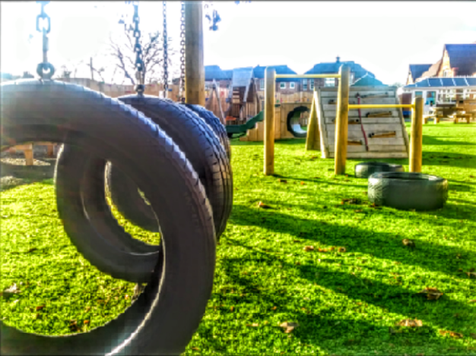
Photographs from our Early Years environment

Slide 23
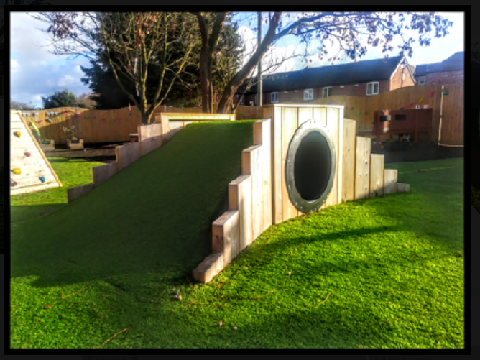
Over, under and through!

Slide 24
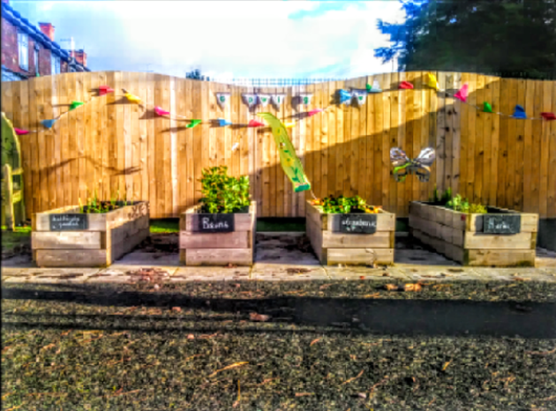
We grow strawberries, herbs, flowers and vegetables.

Slide 25
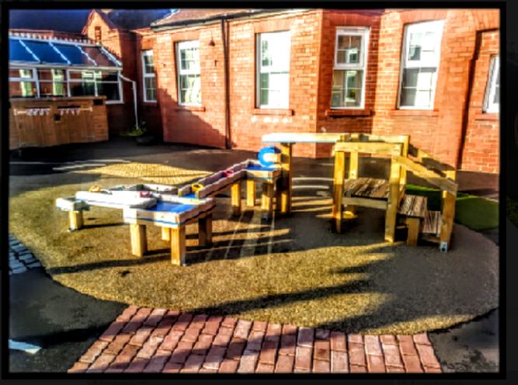
Water discovery and our sensory road.

Slide 26
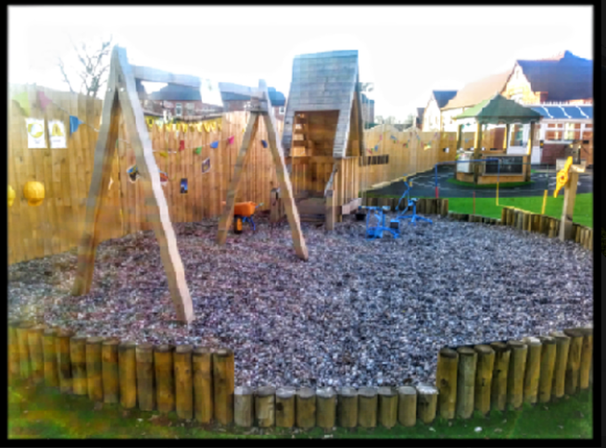
Creative construction in the gravel pit.

Slide 27
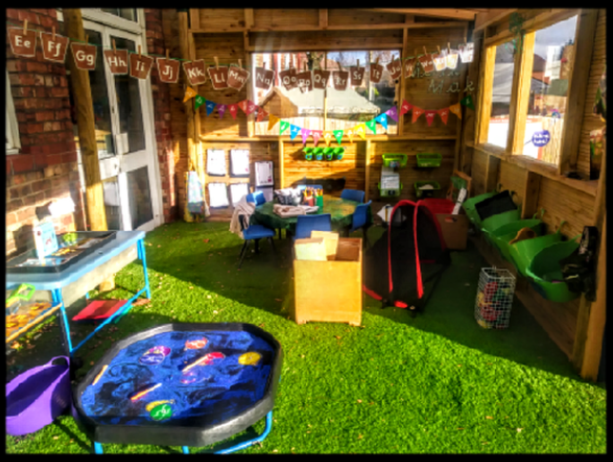
Lots of different activities here!

Slide 28
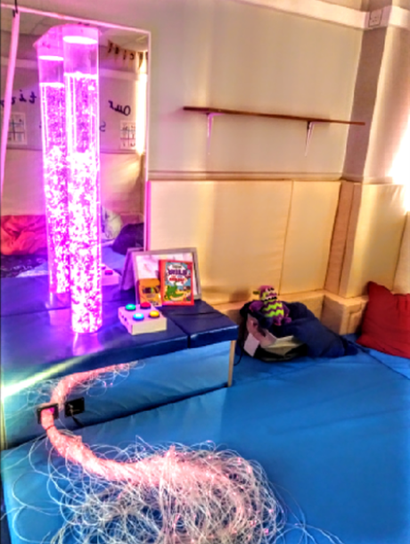
A sensory room for stories, relaxation and mindfulness

Slide 29
Thank You!
Mrs Turner, Mrs Callas and the Early Years Team
We are really looking forward to working with you and your child in September.

Slide 30
Contact Us:
Nantwich Primary Academy and Nursery
Manor Road
Nantwich
Cheshire
CW5 5LX
Principal: Mrs Sue Spence
​
Tel: 01270 902055
nantwichoffice@sbmat.org
Nantwich Primary Academy and Nursery

