Slide 1


Encouraging a growth mindset!
Nantwich Primary Academy and Nursery

Slide 2

Nantwich Primary Academy and Nursery
We are developing our teaching and learning around growth mindsets to promote:-
• a love for learning and self-improvement
• a desire to be challenged
• a willingness to work for positive results
• a belief that you can control the outcomes in your life with effort and practice
• the ability to learn from mistakes and failures
• emotional resilience

Slide 3
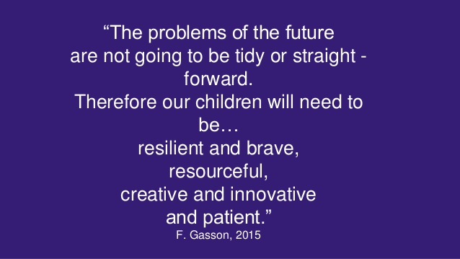

Slide 4

What is mindset?
A mental attitude that determines how you will interpret and respond to situations. It’s also a set of beliefs or a way of thinking that determines one’s behaviour, outlook and mental attitude.
There are two types of mindset Fixed’ and ‘Growth’.
Fixed Mindset:- Intelligence is fixed, Avoid or fear challenges, Give up when things are tough, Make excuses, Don’t try so you won’t fail, Refuse to learn from mistakes.
Growth Mindset:- Intelligence can be developed, Embrace challenge without fear, Keep trying in the tough times, Remember success takes work, Learn from mistakes, Listen to feedback and learn from mistakes

Slide 5
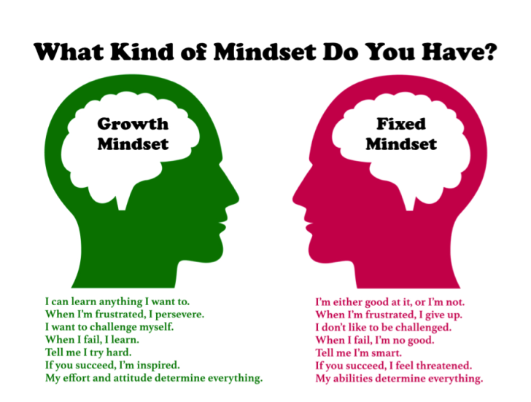

Slide 6
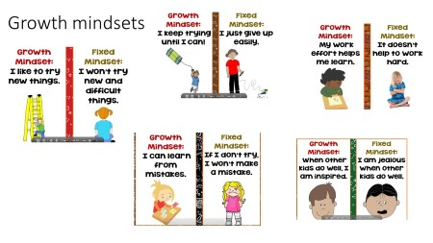

Slide 7
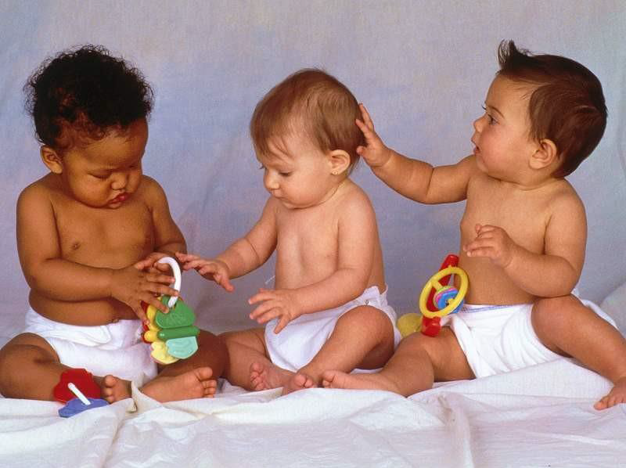

Something to think about!
Why don’t we see unmotivated babies?
As they get older what happens?

Slide 8
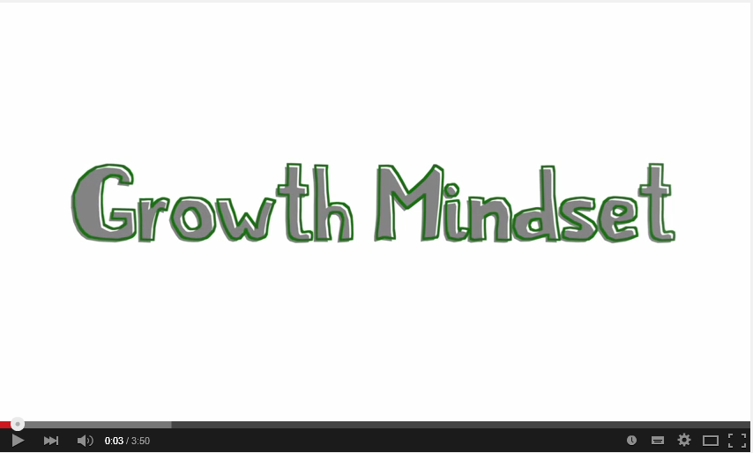
Growth mindset clip

Slide 9
What are Nantwich Primary Academy doing to promote Growth Mindset?
Age appropriate teaching about the brain, how it works and what a growth mindset is.
Teaching of strategies to enable independent learning.
Planning lessons which allow for choice and challenge.
Classroom displays.
Modelling growth mindset language.
Use of stories to introduce and discuss growth mindset.

Slide 10
Messages children can hear which can hinder their learning and mindset.
“You learned that so quickly! You’re so clever!”
Child hears
If I don’t learn something quickly, I’m not clever
“You are brilliant! You got an A without studying.”
Child hears
I’d better stop studying or they won’t think I’m brilliant.
“Look at that drawing! Is he the next Picasso or what?”
Child hears
I shouldn’t try drawing anything hard or they’ll see I’m not.

Slide 11
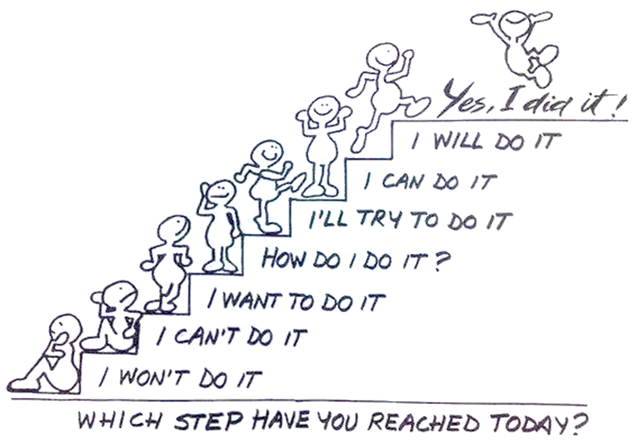
Growth Mindset
I can learn anything I want to
When I’m frustrated, I persevere
I want to challenge myself
When I fail, I learn
I learn from criticism and follow advice
I like to be told that I’m trying hard
If you succeed, I’m inspired
My effort and attitude determine everything

Slide 12
Promoting a growth mindset at home through observations, asking questions or making comments.
Tell me about it.
Show me more.
How did you do that?
How did you figure that out?
How many ways did you try before it turned out the way you wanted?
Are you pleased with it?
What do you think will happen if?
You did it!
You put your own shoes on.
Your brother gave you a huge smile when you shared the bricks..
You have added lots of detail to the faces.
I noticed you are getting better at dribbling the ball. I remember when you couldn’t do that yet.
You worked out a way to share and play together.
Have learning conversations…………….
Share what they’ve learned that day.
What did you practice today at football?
What did you learn today in Maths?

Slide 13
Risk Taking and Making Mistakes
One area we are promoting highly is emotional resilience and the ability to learn from mistakes and to take a risk. Many children have a fear of failure and getting it wrong, which inhibits learning and independence.
Through the growth mindset language we are:-
- Encouraging children to take on a challenge which means children risk getting stuck and making mistakes.
FAlL
First Attempt In Learning

Slide 14

We are promoting with the children that Mistakes are Awesome!
‘The only real mistake is the one from which we learn nothing.’ Henry Ford
Ask questions:- What was the mistake?, Why was it useful?, What did you learn from it?
Encourage children to use the word ‘YET’
Using the word ‘YET’ gives confidence in what they can do but the encouragement to persist. It reinforces that success is possible through effort, different study strategies and resilience.
I‘m not good at my times tables……YET.’ I can’t read….YET!
I tried, but I can’t do it……. YET.’ I don’t understand how to multiply …YET!

Slide 15
In School we use lots of strategies including the power of Praise and Feedback to support growth mindset
Well done you are learning to….
Well done you are getting better at….
What can you learn from your mistake?
What have you learnt that will change what you do next time?
Break it down
Repeat and review
Active learning – make a game, tell someone about it, act it out
Information search
Never give up

Slide 16
Nantwich Primary School as a Growth Mindset School
As a Growth Mindset school we are developing learners that use ‘thinking on purpose’ strategies for growing resilience and as such creating a powerful lever for school improvement.

Slide 17
What does that look like?
It may include;
Classroom teaching that celebrates the struggles and processes and strategies inherent in learning.
Teachers who encourage your child to be a flexible, confident learner - try new things out if they get stuck.
An inclusive atmosphere with zero tolerance of ‘put downs’, and one that encourages children to give unconditional support to others.

Slide 18

All staff model a growth mindset by being outstanding learners themselves, and share this attitude with their classes.
Children are rewarded for effort as well as their attainment.
Children are challenged to stretch their own comfort zones academically, physically and personally, to promote resilience, confidence and flexibility.
Children know what their strengths are and what they need to do to improve.

Slide 19
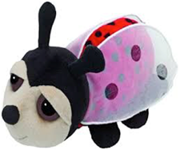
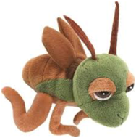

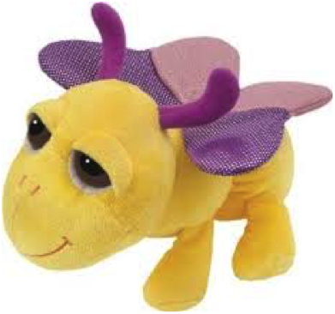
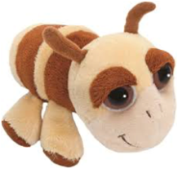
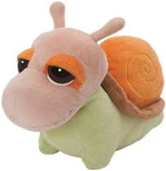
Here at Nantwich Primary Academy we encourage all children to improve their learning through the 6 Learning Powers.
This is a very powerful way in which children can improve their Growth Mindset.
Resourcefulness
Respect
Resilience
Risk taking
Reflectiveness
Reciprocity

Slide 20
Questions you could ask your child at the end of the school day
What did you learn today that surprised you?
Did you make any good mistakes today? How did you learn from them?
What did you do today that was so hard it made your brain grow?
How did you help someone else learn something new today?

Slide 21
Parents should not shield their children from challenges, mistakes, and struggles. Instead parents should teach children to love challenges. They can say things like, “This is hard. What fun!” or “This is too easy. It’s no fun.” They should teach their children to embrace mistakes.”Ooooh, here’s an interesting mistake. What should we do next?” And they should teach them to love effort: “That was a fantastic struggle. You really stuck to it and made great progress” or “This will take a lot of effort –boy will it be fun!”
Dr. Carol Dweck

