Slide 1
NPA Knowledge Organiser: Year 6 – Autumn term
PETS

Slide 2
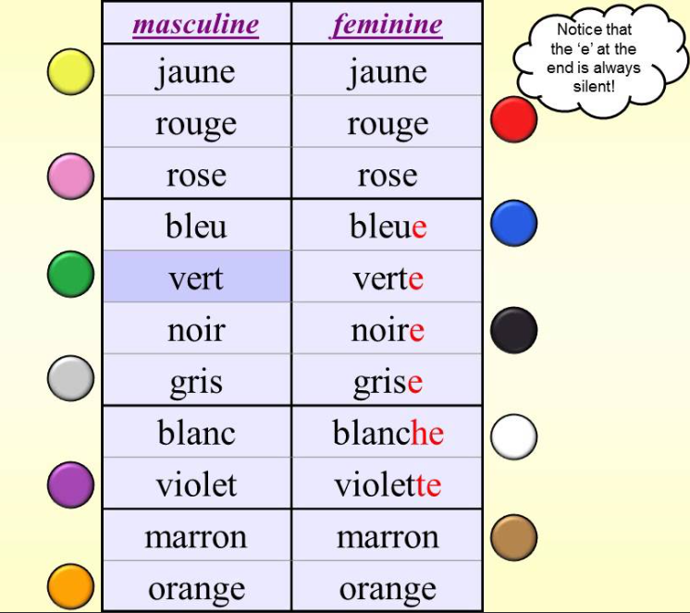
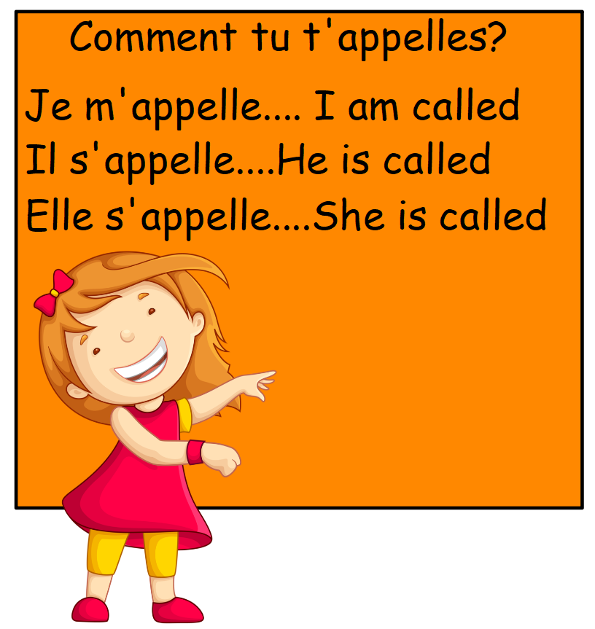
NPA Knowledge Organiser: Year 6 – Autumn
The points of the compass - Les points cardinaux

