Slide 1
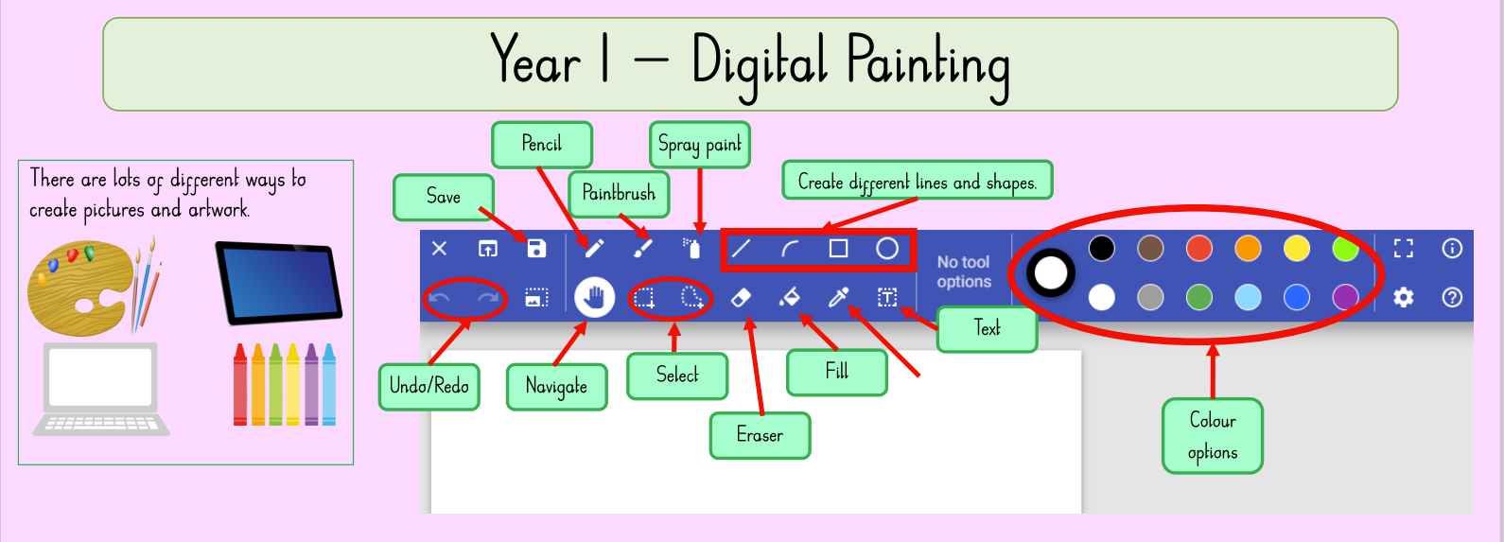
NPA Knowledge Organiser: Year 1 Computing Autumn – Digital painting
“Computers are incredibly fast, accurate, and stupid. Human beings are incredibly slow, inaccurate, and brilliant. Together they are powerful beyond imagination.”- Albert Einstein, physicist
In Autumn 1 we will be learning about the different parts of a computer and using paint programmes to create digital paintings.
Mouse
Monitor
Keyboard
Touchpad
Screen
Erase
Paint
Fill
Spray
Draw
Save

