Slide 1
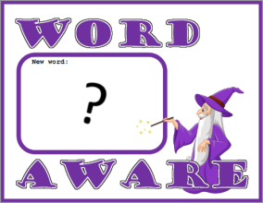
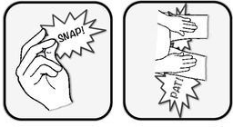
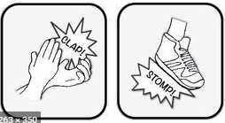
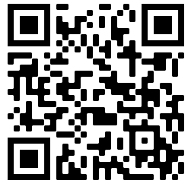
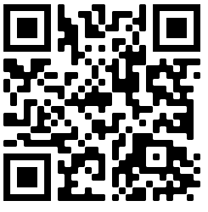
NPA Knowledge Organiser: Year 1 Music – Autumn term
Sing a song! ‘London’s Burning’ is a song derived from the great fire of London
https://www.youtube.com/watch?v=5Atpbo3wOts9+*
Listen and Respond
Different What were seaside holidays like in the past? People have been going on seaside holidays in the UK for over a hundred years. Rail travel made it cheaper and easier for people to travel to the coast with their families. Many things that we see at the seaside now such as donkey rides, arcades and buckets and spades have been enjoyed by people of all ages for many years. However, not everything is as it was 100 years ago. For example do you know about bathing machines? They were wooden carts that ladies could get changed in because it was considered rude to be seen in a swimming costume. They were then rolled into the sea and ladies could go straight from the cart into the sea without being seen!
By the end of the unit children will be able to:
Choose sounds to represent different things (ideas, thoughts, feelings, moods etc.)
Reflect on music and say how it makes people feel, act and move
Explore the use of the voice in different ways such as speaking, singing and chanting.
Create a sequence of long and short sounds
Investigate making sounds that are very different (loud and quiet, high and low etc.)
Children will have the opportunity to learn and use words such as:
beat – the steady pulse of the music
chant - a repeated phrase shouted or sung together
dynamics – how loud or quiet music is
round – a song that can be sung by groups of people starting at different times
tempo – the speed of a piece of music
Body percussion
Composer
Listen to ‘London’s burning’
being sung in a round
Watch
orchestras perform

