Slide 1
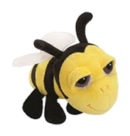
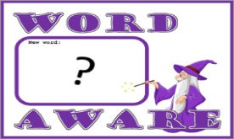
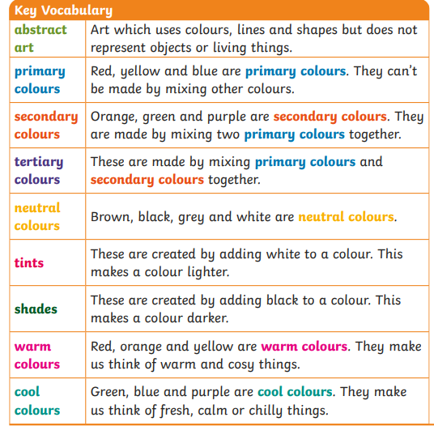
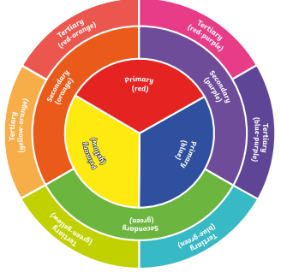
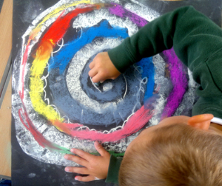
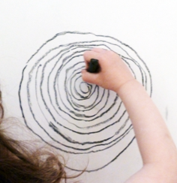
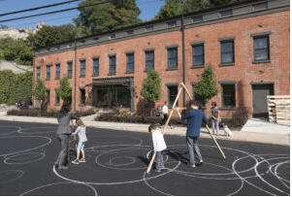
NPA Knowledge Organiser: Year 1 ART
Spirals
Drawing spirals
Molly Haslund: Outdoor Drawings
Molly created huge spirals and circles outside.
Watch a video of Molly Haslaund
Circles 2013 - Molly Haslund

