Slide 1
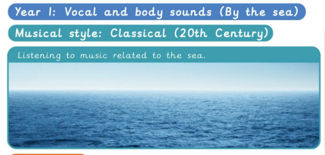
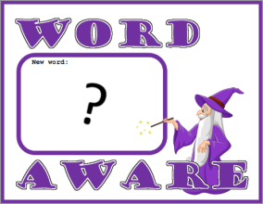
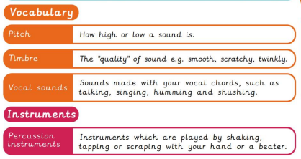
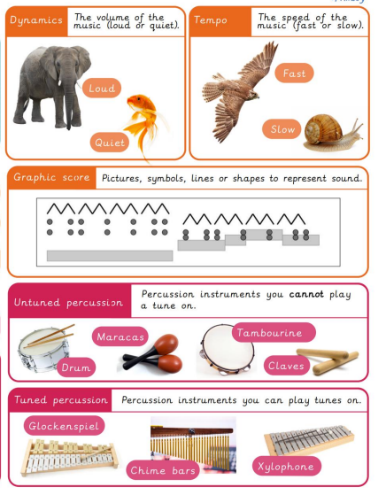
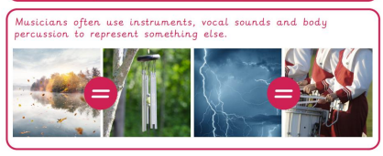
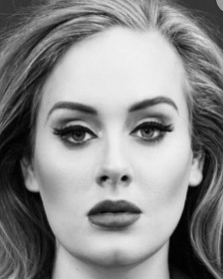
NPA Knowledge Organiser: Year 1 Music – Autumn – Vocal and body sounds
In Autumn 1 we will be making sounds using our bodies and voices.
‘I don’t make music for eyes, I make music for ears’- Adele

