Slide 1
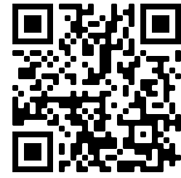
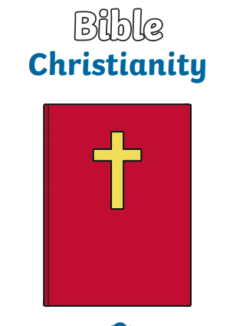
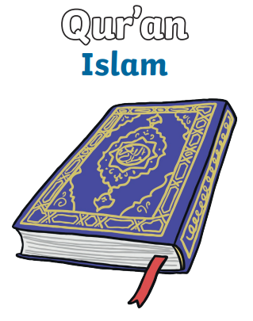
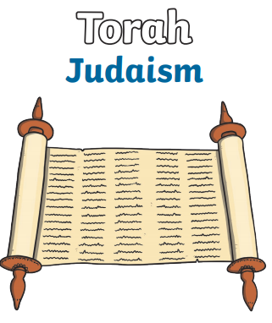
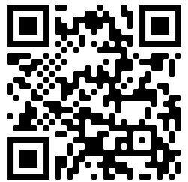
NPA Knowledge Organiser: Year 1 RE – Autumn term 1
Sing a song! ‘London’s Burning’ is a song derived from the great fire of London
https://www.youtube.com/watch?v=5Atpbo3wOts9+*
Thanking God for Nature
Different What were seaside holidays like in the past? People have been going on seaside holidays in the UK for over a hundred years. Rail travel made it cheaper and easier for people to travel to the coast with their families. Many things that we see at the seaside now such as donkey rides, arcades and buckets and spades have been enjoyed by people of all ages for many years. However, not everything is as it was 100 years ago. For example do you know about bathing machines? They were wooden carts that ladies could get changed in because it was considered rude to be seen in a swimming costume. They were then rolled into the sea and ladies could go straight from the cart into the sea without being seen!
Different faiths have different beliefs about how the world was created
Christians, Muslims and Jews share the belief that their God created the world
Christians show that they are thankful for the natural world by holding Harvest festivals and saying thank you to God with songs and sharing with others
Jews show they are thankful for the natural world at Sukkot; they build temporary huts (Sukkah) to live in to feel closer to God
Muslims believe that Allah has made them guardians of the creation and that hey have to look after the natural world
Children will have the opportunity to learn and use words such as:
creation
Christians
Jews
Muslims
God
created
beautiful
natural
puzzling
wonderful
world
Listen to Louie Armstrong ‘What a Wonderful World
Watch
Cbeebies ‘Daydreams’

